Slide 1
Public Service Loan Forgiveness – Limited Waiver
Barbara K. Mistick
President
NAICU
Ashley Harrington
Senior Advisor to the COO
Department of Education’s Office
of Federal Student Aid
June 23, 2022

Slide 2
Poll Questions
Do you have student loans?
Yes
No
What percentage of the employees you work with have student loans?
More than 50%
25-50%
10-24%
Less than 10%
Not sure
Do you know about the Public Service Loan Forgiveness program?
Yes
No
Do you know about the Limited PSLF Waiver
Yes
No

Slide 3
Public service loan forgiveness (pslf) program

Slide 4
Targeted Student Loan relief
The department has approved more than $25 Billion in debt cancellation for 1.3 million borrowers
$7.3 billion for more than 127,150 public servants through improvements to PSLF;
Over $8.5 billion for more than 400,000 borrowers who have a total and permanent disability;
$7.9 billion for 690,000 borrowers whose institutions took advantage of them through discharges related to borrower defense and school closures.

Slide 5
Limited Pslf waiver
The limited pslf waiver has impacted Hundreds of thousands of borrowers
To date, the Department has approved $7.3 billion in forgiveness for 127,150 borrowers through the Limited PSLF Waiver.
The waiver has brought another 1.1 million borrowers closer to forgiveness, with the average borrower picking up a year’s worth of credit.
More than a quarter of a million borrowers got 2 years or more of additional credit toward forgiveness.
These numbers will all continue to grow as the Department continues to process paperwork and review files.

Slide 6
PSLF Basics
120 qualifying payments…
While working for a qualifying employer
Forgiven amount is not taxable income
…on Direct Loans…
…when applying for and receiving PSLF

Slide 7
PSLF Basics: Eligible Loan Types
Direct Loans, including:
Consolidation Loans
Parent PLUS Loans
FFEL Program Loans
Perkins Loans
Any other federal or private student loan

Slide 8
PSLF Basics: Eligible payments
On-time
In a Standard Plan or any IDR plan
For at least the amount due
Can be non-consecutive
More than 15 days late
In a Graduated, Extended, or Alternative plan
For less than the amount due
Made when not required (e.g. in-school deferment)

Slide 9
PSLF Basics: Eligible Employment
Full-time (30 hours/week) or equivalent
Government (including military)
All 501(c)3 non-profits
Some limited exceptions
Part-time work that does not add up to full-time
Volunteer work
For-profit entities
Including those that employ essential workers
Labor unions

Slide 10
Temporary Expanded PSLF
Provides loan forgiveness to those who do not qualify for PSLF only because some or all their qualifying payments were made on non-qualifying plans
Extended and Graduated, if:
In the 12 months before applying for TEPLSF, the borrower paid at least the amount they would have paid under an IDR plan
Alternative

Slide 11
Limited PSLF Waiver: Through 10/31/22
Payments made prior to consolidation are now eligible
No matter the loan program (DL, FFEL, Perkins)
No matter the repayment plan
No matter the loan type (with the exception of Parent PLUS)
Must have been employed
full-time and
for a qualifying employer
when prior payments were made
Employment requirements still apply
Borrowers who still have FFEL and Perkins Loans can only get credit for past payments if they consolidate into DL and file PSLF Forms for prior employment before Oct. 31, 2022. After Oct. 31, 2022, normal PSLF and TEPSLF requirements will apply.
Borrowers must act now

Slide 12
PSLF Limited Waiver: Borrower groups
StudentAid.gov/PSLFWaiver
If You only borrowed direct loans…
If you previously consolidated into Direct Loan(s)
If you still have FFEL or Perkins Loans…
File a PSLF Form for each eligible employer you had since you borrowed the loan (or since Oct. 1, 2007, whichever is later)
File a PSLF Form for each eligible employer you had since you borrowed any loans underlying the Direct Consolidation Loan (or since Oct. 1, 2007, whichever is later)
Consolidate your loans into the Direct Loan Program and file a PSLF Form for each eligible employer since you borrowed the loans you are consolidating (or since Oct. 1, 2007, whichever is later)

Slide 13
To take advantage of the waiver:
Confirm your employer is qualified.
Consolidate your loans if you need to.
Submit your PSLF form(s).
By Oct. 31, 2022

Slide 14
Update: IDR and PSLF Account adjustments
In the coming months, FSA will:
Conduct a One-Time Revision of IDR Payments to Address Past Inaccuracies
Any months in which borrowers made payments will count toward IDR, regardless of repayment plan
Any borrower who has made the required number of payments for IDR forgiveness based on this payment-count revision will receive loan cancellation automatically.
Count months spent in deferment prior to 2013 toward IDR forgiveness (excluding in-school deferment)
Conduct a One-Time Account Adjustment to Count Long-Term Forbearances toward IDR and PSLF Forgiveness
Count forbearances of more than 12 months consecutive and more than 36 months cumulative toward forgiveness under IDR and PSLF
Borrowers who were steered into shorter-term forbearances csn seek account review by filing a complaint with the FSA Ombudsman at StudentAid.gov/feedback
FSA will begin work on implementing these changes immediately, but borrowers may not see the effect in their accounts until the last quarter of 2022.

Slide 15
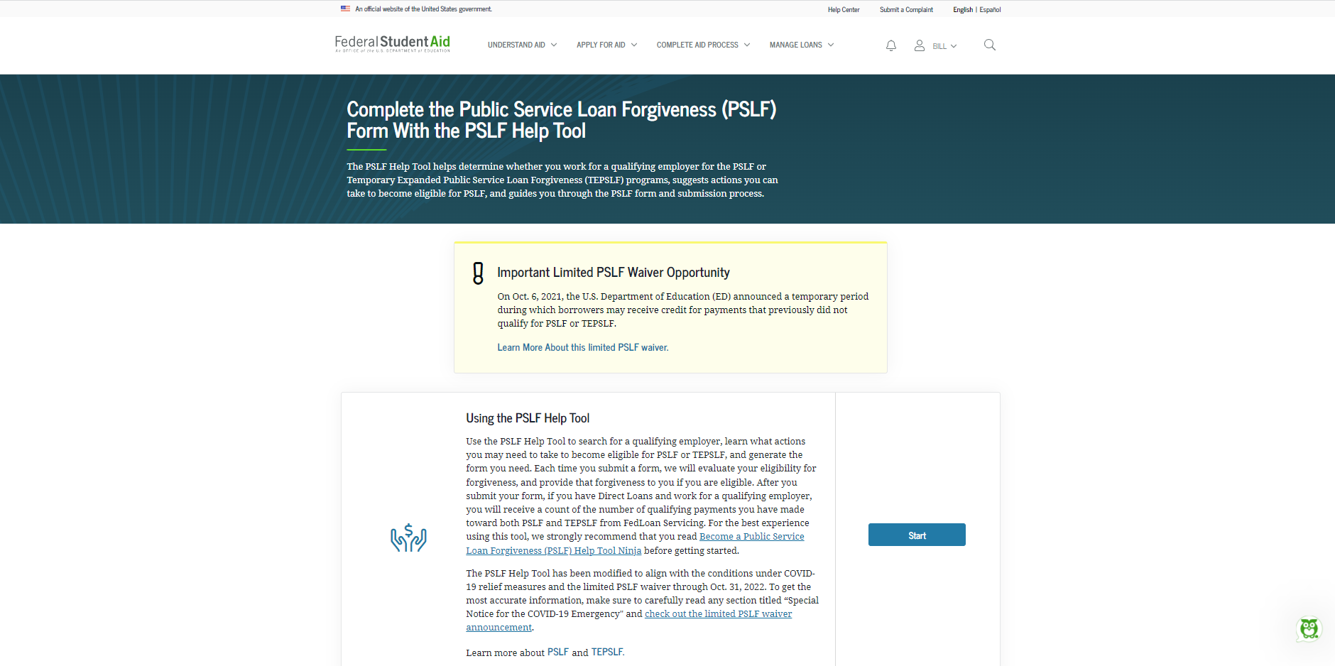
PSLF Help Tool Landing PAge

Slide 16
PSLF Information and Resources
Limited pslf waiver
Pslf help tool
StudentAid.gov/pslfwaiver
StudentAid.gov/pslf
General pslf information
StudentAid.gov/publicservice
Make sure to review the FAQs!
The PSLF Servicer is currently FedLoan Servicing, who is still managing the program. Later this year, PSLF will transition to MOHELA. More information to come!

Slide 17
Questions?

Slide 18
Poll Questions
Are you able to share this information about Public Service Loan Forgiveness with your employees and alumni?
Yes
No
Do you think PSLF will help you with employee retention and recruitment?
Yes
No
If you have student loans, do you feel motivated to apply for Public Service Loan Forgiveness?
Yes
No
Not Applicable

