Slide 1

FEMA Public Support for Private, Nonprofit
Colleges & Universities
Barbara Mistick
President
NAICU
Colleen Vivori
Program Analyst for Public Assistance Policy
FEMA
Kathy O’Connell
Program Analyst | Regulations & Policy Branch | Public Assistance Division
FEMA
Monica McMillan
Team Lead
State/Local/Tribal/Territorial of FEMA’s Public Assistance Training Section

Slide 2
Agenda
Welcome & Introductions
FEMA’s Available Resources for Colleges & Universities
  COVID-related Expenses
  Other Natural Disasters
Accessing FEMA’s Resources
Q&A

Slide 3
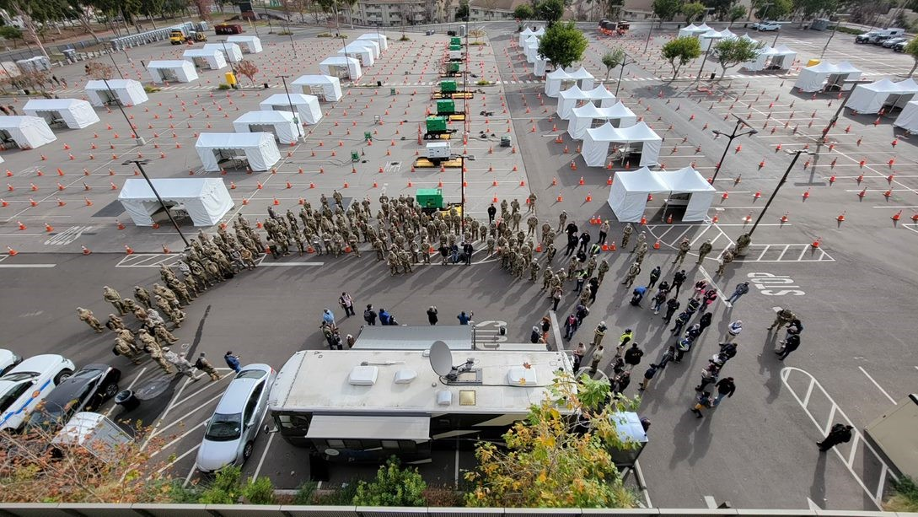
COVID-19 Pandemic: Public Assistance
January 2022

Slide 4
General Public Assistance Eligibility

Slide 5
Public Assistance Applicants, Recipients, & Subrecipients
Once a disaster has been declared, multiple layers of government work in partnership to administer the PA Program:
FEMA
The federal awarding agency authorized to manage the program.
Recipients
The State, Territorial, or Tribal government that receives funding under the disaster declaration and disburses funding to approved subrecipients.
Applicants
Entities submitting a request for assistance under the recipient’s federal award.
Subrecipients
Applicants who have received a subaward from the Recipient and are then bound by the conditions of the award and subaward.

Slide 6
PNP and Government Eligibility Pyramids
Eligibility of PNPs and Government Applicants is determined differently, though the same criteria are considered for all damages. The ownership of the facility, type of services the PNP provides, and the population served are all part of the eligibility determination.
Government Applicants (State, Local, Territorial and Tribal)
Private, Non-Profit Entities (PNPs)
COST
COST
WORK
WORK
FACILITY
APPLICANT, FACILITY, SERVICES
APPLICANT

Slide 7
PNP Eligibility
Only certain PNPs are eligible for PA.
To be an eligible PNP Applicant, the PNP must first demonstrate that it has either:
  A ruling letter from the U.S. Internal Revenue Service (501(c), (d), or (e)); OR
  Documentation from the State substantiating it is a non-revenue producing, nonprofit entity organized or doing business under State law
FEMA must then also determine whether the PNP owns or operates a facility that provides an eligible service which is defined as either:
  A critical service which is defined as education, utility, emergency medical, or other emergency service (e.g., fire and rescue); OR
  A noncritical service that provides an essential social-type service

Slide 8
Public Assistance COVID-19 Overview and General Eligibility Considerations

Slide 9
General Eligibility Considerations for COVID-19
Work must be the legal responsibility of an eligible applicant.
  Measures to protect life, public health, and safety are generally the responsibility of State, Local, Territorial and Tribal (SLTT) governments.
Legally-responsible SLTT governments may enter into formal agreements or contracts with private organizations, including PNP organizations.
  In limited circumstances, essential components of a facility are urgently needed to save lives or protect health and safety. In these cases, PNPs that own or operate an eligible facility and perform eligible work may be eligible for reimbursement of costs as a PA applicant.

Slide 10
Additional Considerations
To be eligible, claimed costs must be necessary and be reasonable pursuant to federal regulations and federal cost principles.
FEMA is prohibited from providing financial assistance where such assistance would duplicate funding available from another program, insurance, or any other source for the same purpose
The federal cost share under PA for all COVID-19 declarations was increased from 75% to 100% for all eligible work already performed or to be performed from January 20, 2020 through April 1, 2022.

Slide 11
Equitable Pandemic Response and Recovery
COVID-19 has a disproportionate impact on communities of color and other underserved populations.
SLTT governments must focus the use of FEMA funding on the highest-risk and hardest-hit communities and underserved populations.
SLTT governments must prioritize limited resources to ensure an equitable pandemic response.
The distribution of disaster relief be accomplished in an equitable and impartial manner, without discrimination.
These grant conditions will be monitored by FEMA.

Slide 12
COVID-19 Medical Care Policy

Slide 13
Medical Care Costs Eligible for Public Assistance Policy – Eligibility
Eligible PA Applicants under the COVID-19 emergency declaration or any subsequent COVID-19 major disaster declaration, including:
  SLTT government entities; and
  PNP organizations that own and/or operate medical facilities.
    SLTT governments may contract with medical providers, including private entities, to carry out any eligible activities.

Slide 14

Medical Care Costs Eligible for Public Assistance – Background
For COVID-19, SLTT government entities and certain PNP organizations are eligible to apply for PA for COVID-related medical care.
Medical care and associated costs refer to assistance to support the provision of medical care, including eligible facility, equipment, supplies, staffing, and wraparound services as well as assistance for clinical care of patients not covered by another funding source.
  Primary Care Facilities
  Temporary and Expanded Facilities
  Vaccinations

Slide 15
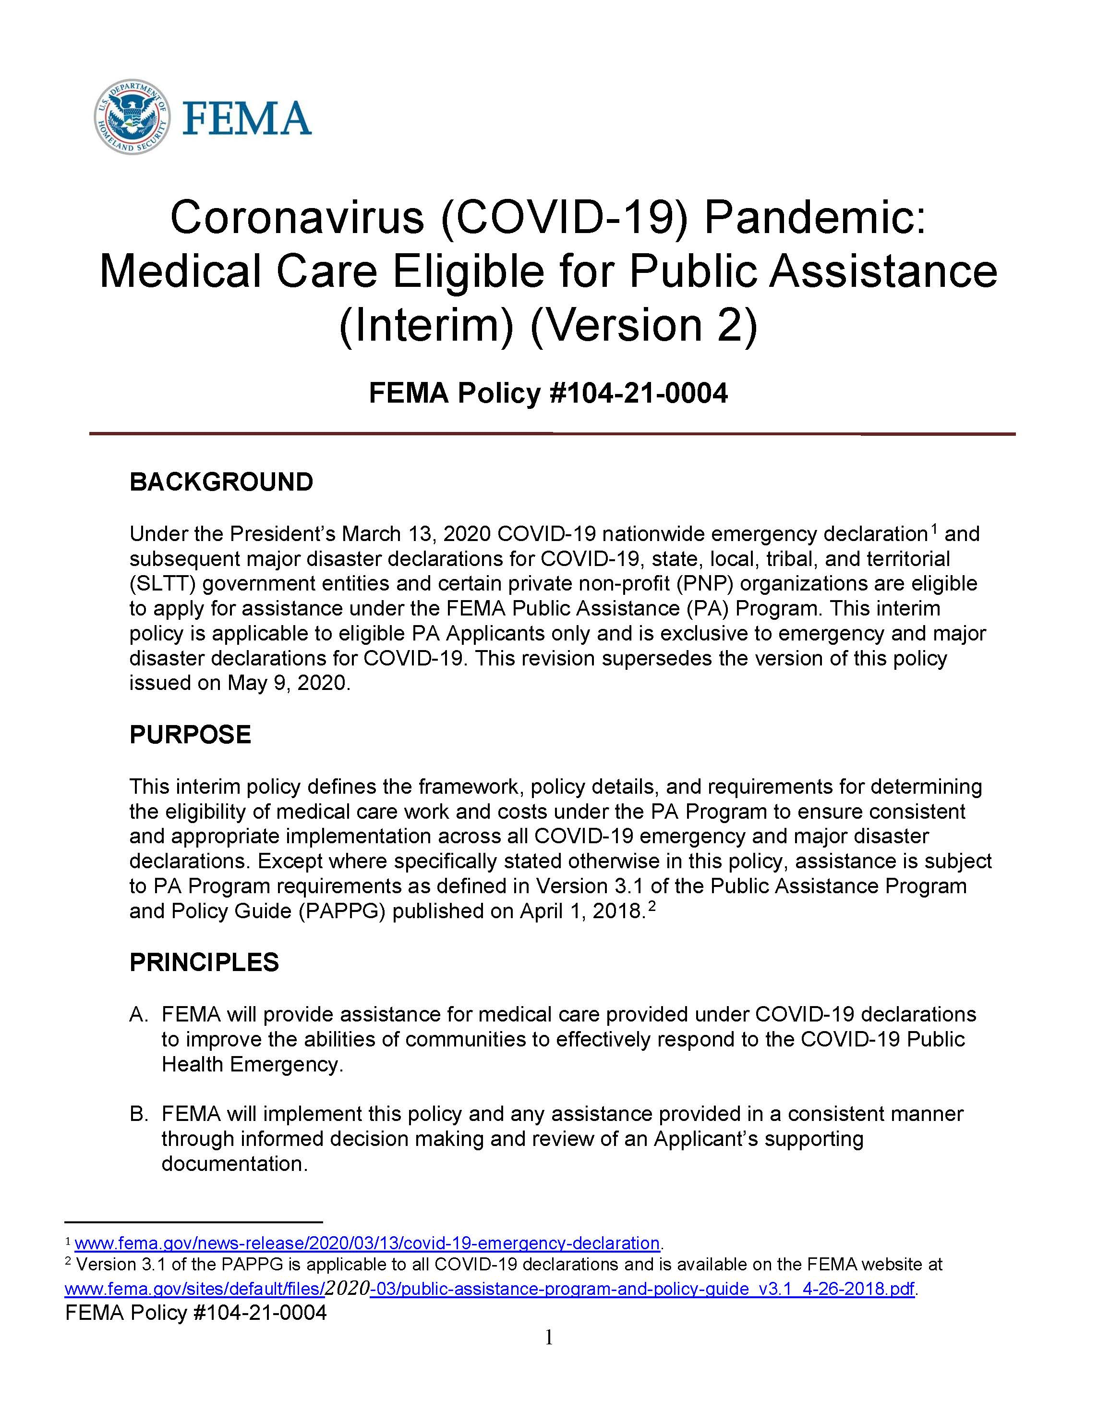
Medical Care Costs Eligible for Public Assistance Policy – Vaccinations
Work and associated costs to support the distribution and administration of COVID-19 vaccines may be eligible for PA.
  The cost of the vaccine itself is covered by the federal government
  Additional costs to support the distribution and administration of the vaccine may be eligible under PA when consistent with established vaccine protocols, CDC and/or other applicable public health guidance, and PA program requirements

Slide 16
Community Engagement for COVID-19 Vaccinations
FEMA PA funding is available for community engagement and information dissemination.
Supports completion of vaccination mission and increases public confidence in and uptake of COVID-19 vaccines.
Activities promote vaccination availability, scheduling, and accessibility.
Funding is eligible under current FEMA policies and is available to SLTT governments and eligible PNP medical facilities carrying out vaccination administration activities.

Slide 17
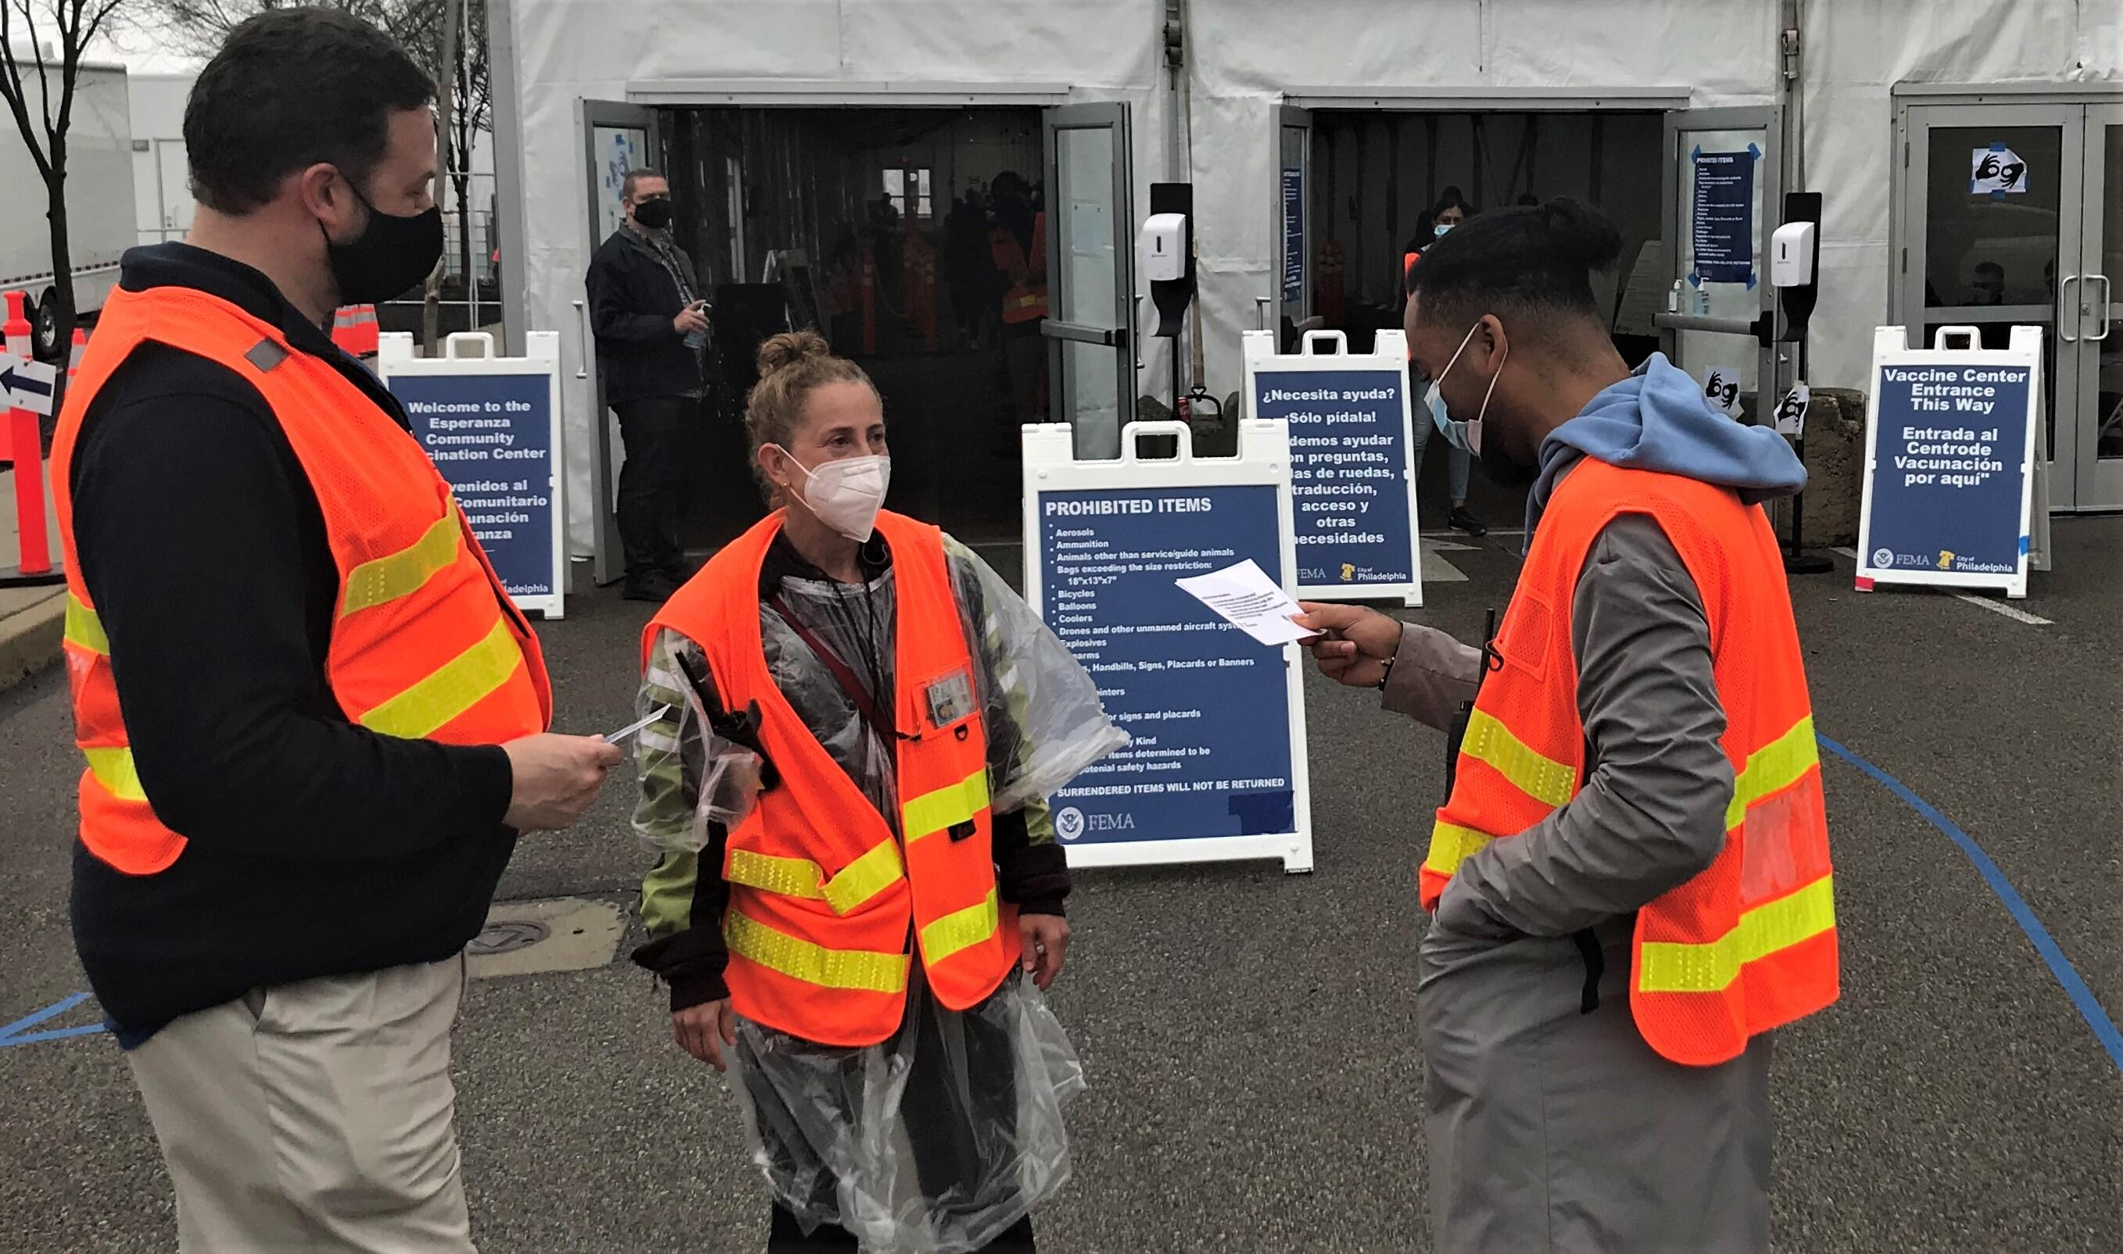
FEMA Assistance for Employer Vaccinations
Standard PA eligibility still applies
Pop-up vaccination sites at a work site would be considered a temporary facility to augment vaccination efforts like any other CVC
SLTTs and eligible PNP facilities would be eligible for such sites at their own facilities in accordance with the medical care policy
For private entities, only SLTTs would be eligible to set up pop-up vaccination sites at a work site when doing so as the legally responsible entity

Slide 18
Costs Eligible for Public Assistance Policy – Testing
FEMA will fund testing to detect COVID-19 infections including:
  Testing in a medical setting (primary medical care facilities, temporary medical care facilities, and community-based testing sites)
  Testing needed to safely open and operate public facilities, including schools and government offices.
Funding may be used to support both diagnostic and screening protocols.
In general, FEMA will fund diagnostic and screening testing to determine if an active coronavirus infection is present and if an individual should take steps to quarantine or isolate from others.
Notes:
Funding guidelines for medical settings are outlined in FEMA Policy 104-010-04, Coronavirus (COVID-19) Pandemic: Medical Care Costs Eligible for Public Assistance. Guidelines for other facility settings are outlined in FEMA Policy 104-21-0003, Coronavirus (COVID-19) Pandemic: Safe Opening and Operation Work Eligible for Public Assistance (Interim).

Slide 19
COVID-19 Safe Opening and Operations Policy

Slide 20
Safe Operation and Opening Policy – Background
On January 21, 2021, the President issued the “Memorandum to Extend Federal Support to Governors’ Use of the National Guard to Respond to COVID-19 and to Increase Reimbursement and Other Assistance Provided to States”
  This authorized FEMA to provide funding to all PA-eligible Applicants for the safe opening and operation of eligible facilities.
  The expanded eligibility timeframe under the policy is from the beginning of the incident period through the end of the period of performance.
  Applies to all emergency and major disaster declarations for COVID-19.
  Work that is otherwise eligible under the COVID-19 Work Eligible for Public Assistance Interim Policy remains eligible for assistance.

Slide 21
Safe Operation and Opening Policy – Eligible Costs
FEMA may provide assistance to all eligible PA applicants, including SLTTs and eligible PNPs, for the following measures implemented to facilitate the safe opening and operation of eligible facilities:
  Purchase and distribution of cloth face coverings and PPE
  Cleaning and disinfection
  COVID-19 diagnostic testing
  Screening and temperature scanning
  Acquisition and installation of portable temporary physical barriers
  Purchase and storage of PPE and other supplies based on projected needs
Notes:
For this policy, PPE is defined to include items such as N95 and other filtering respirators, surgical masks, gloves, protective eyewear, face shields, and protective clothing (e.g., gowns). Eligibility includes necessary training for proper use of PPE.

Slide 22
FEMA COVID-19 Resources
COVID-19 Policy: Medical Care Eligible for Public Assistance (Interim), Version 2
COVID-19 Policy: Safe Opening and Operation Work Eligible for Public Assistance (Interim), Version 2
COVID-19 Fact Sheet: Private Nonprofit Organizations
FEMA.gov: How to Apply for Public Assistance
FEMA.gov: COVID-19 Education Resource Roadmap

Slide 23
Contact Slide Option 2
For additional information,
contact your state emergency management office
FEMA.gov/locations

Slide 24
Introduction to FEMA’s Public Assistance
Grants Portal
NAICU Presentation| Jan 2022

Slide 25
Overview
Public Assistance Process Overview
Introduction to Grants Portal System
Submitting a Request for Public Assistance
Streamlined Project Application Overview
Resources

Slide 26
Terms to Know - System & Process
Grants Portal
FEMA grant platform used by Recipients and Applicants to manage PA Grant Applications
Request for Public Assistance
Official mechanism by which starts the process for a potential Applicant requests and is approved to receive Public Assistance funding from FEMA through the Recipient. The Request for Public Assistance (RPA) will be reviewed by the Recipient and FEMA staff,

Slide 27
Terms to Know
Direct Applicant Process
Enables Applicants to navigate the PA grants process without the assignment of a Program Delivery Manager (PDMG)
Streamlined Project Applications
Allows Applicants to directly input activities and supporting documentation in Grants Portal to formulate a project– Emergency Work (Category A & B) & Management Costs (Category Z) only
A customer service manager who works with Applicants to resolve disaster-related needs and ensure that the Applicant’s projects are processed as efficiently and expeditiously as possible.
Program Delivery Manager (PDMG)
Notes:
PDMGs aren’t always assigned to COVID applicants, but can be requested by the organization who’s applying. This is done through the Recipient

Slide 28
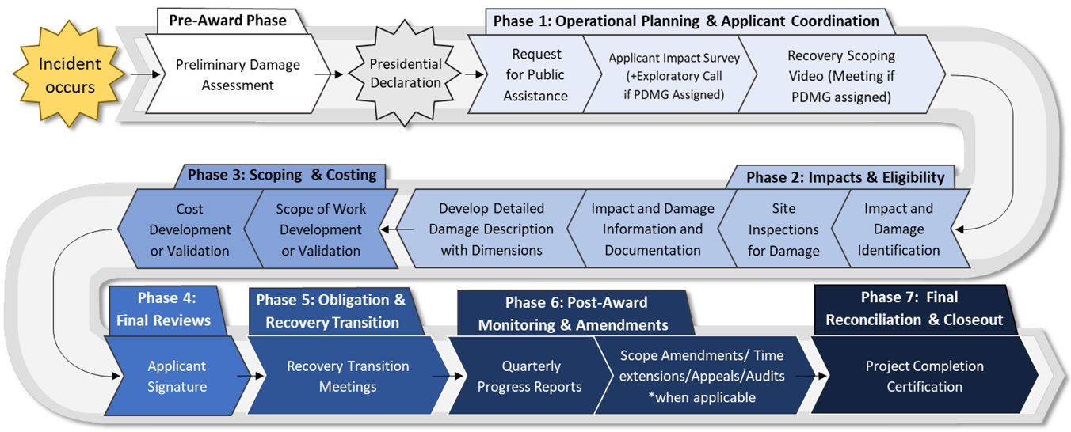
Public Assistance Award Process Overview Workflow Chart
Notes:
PA Award Process Overview and where Actions in Grants Portal fall into it.

Slide 29
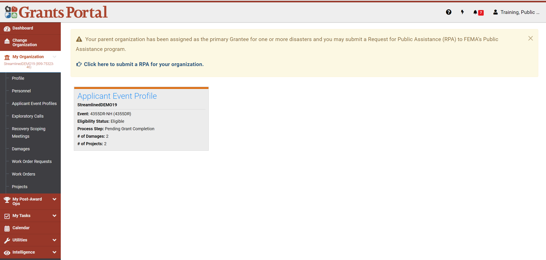
My Dashboard
Banner: Always on top of screen.
Grants Portal – takes users back to Dashboard.
(?) – Opens Support Center
Lightning Bolt – Quick actions (filters & SPA submission)
Task Bell – list of outstanding tasks
Avatar – Standard drop down like sign out and profile

Slide 30

Request for Public Assistance (RPA):
Private Non-Profit
Notes:
Private Non-profits must have their organization profiles approved by the Recipient before they can submit a Request for Public Assistance

Slide 31
Submit RPA from Dashboard
Click to Submit RPA

Slide 32
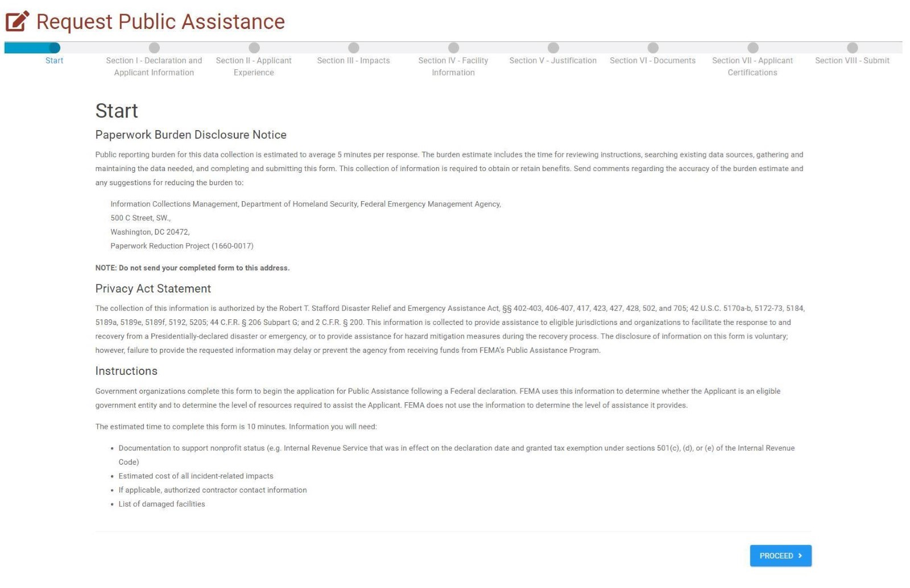
Request for Public Assistance - Start
Step 1: Read and Save the following information
Step 2: Click Proceed
Notes:
There is no download button on this page, but the system tries to give you some help as it guides you though the RPA and later on through the Project process

Slide 33
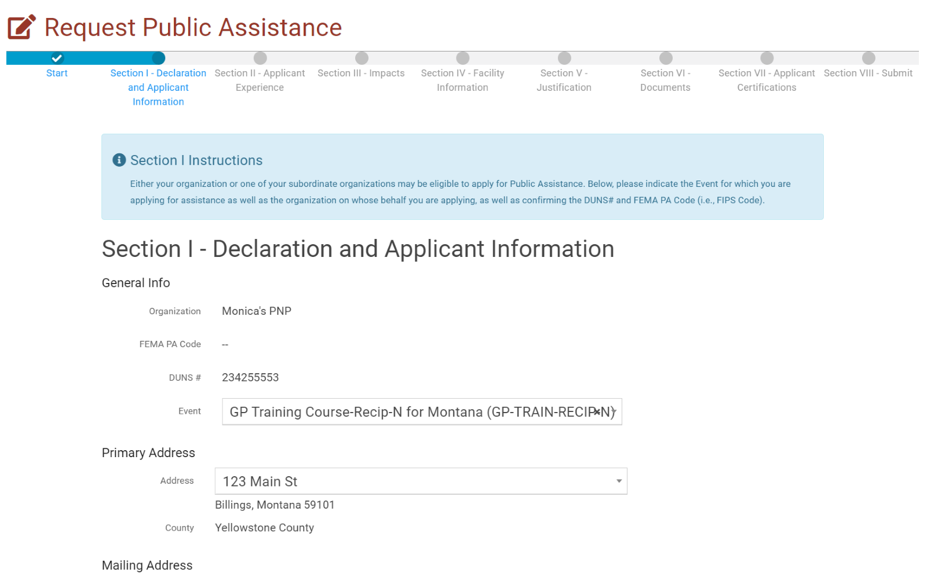
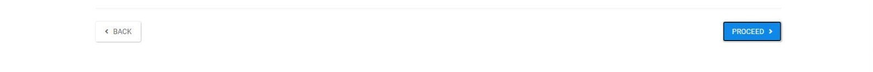
RPA - Declaration and Applicant Information
Enter the following information
Click Proceed
Notes:
Section 1 contains several drop downs that pull information from your Organization Profile. If the information here is incorrect, you will have to exit the Request for Public Assistance and fix it in your Organization Profile before continuing.

Slide 34
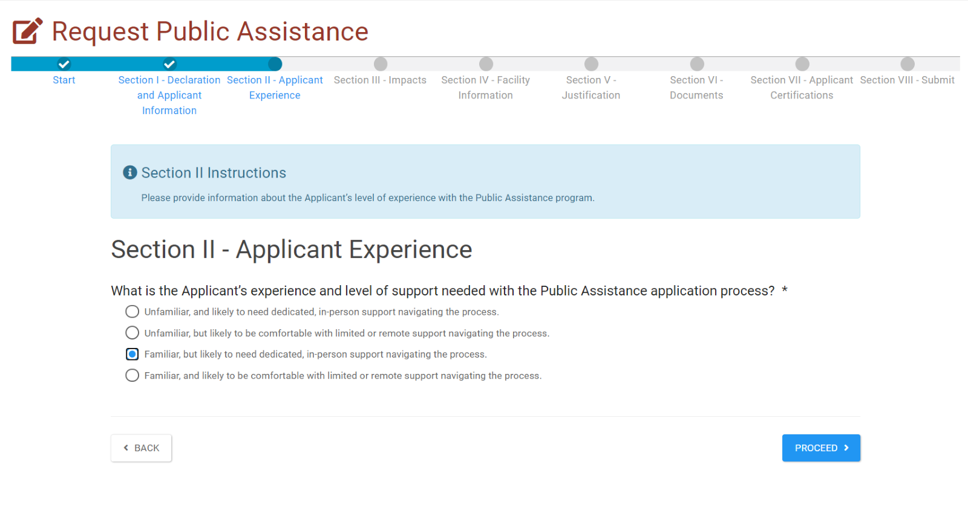
RPA - Applicant Experience
Select the Applicable Answer
Notes:
Where you see the round radial buttons, you can only select one, later on in the process where you see boxes, you’ll be able to select multiple responses to the questions.

Slide 35
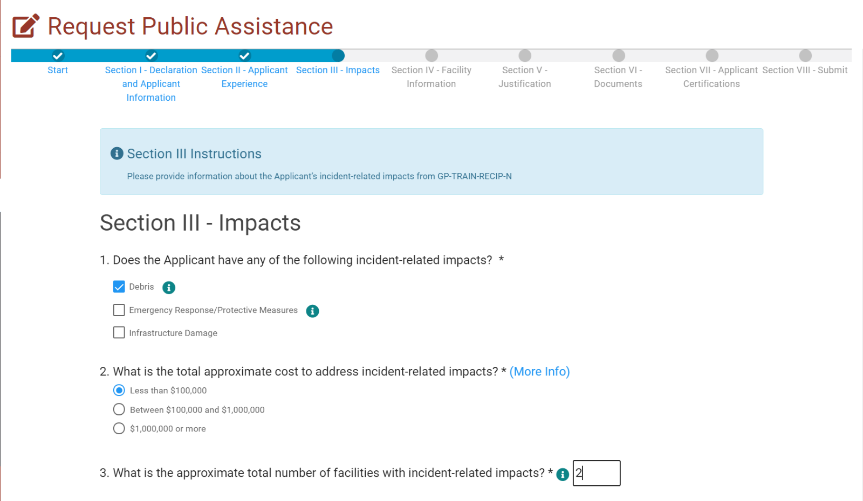
RPA - Impacts 1/2
This Section will give your Program Delivery Manager an understanding of how the event effected your organization

Slide 36
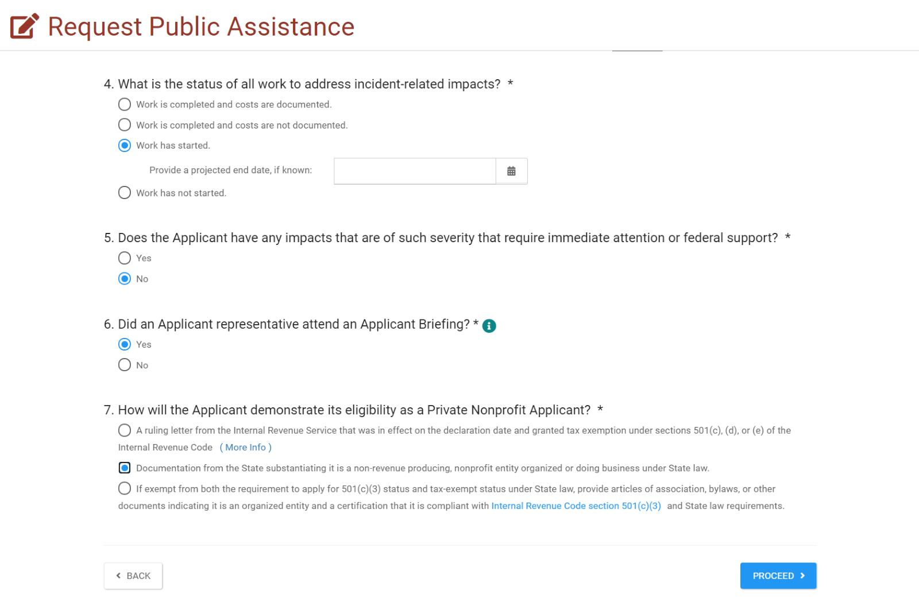
RPA - Impacts 2/2
Select or Enter the Applicable Answer
Click Proceed

Slide 37
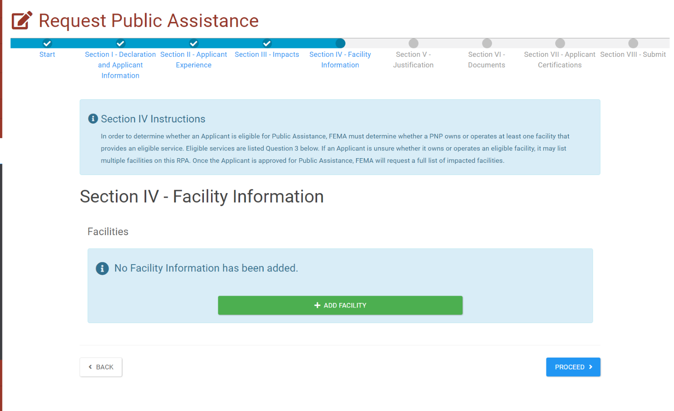
RPA - Facility Information 1/6
FEMA must determine whether a PNP owns or operates at lease one facility that provides an eligible service. If unsure if it owns or operates an eligible facility several can be listed in this section
Click + Add Facility

Slide 38
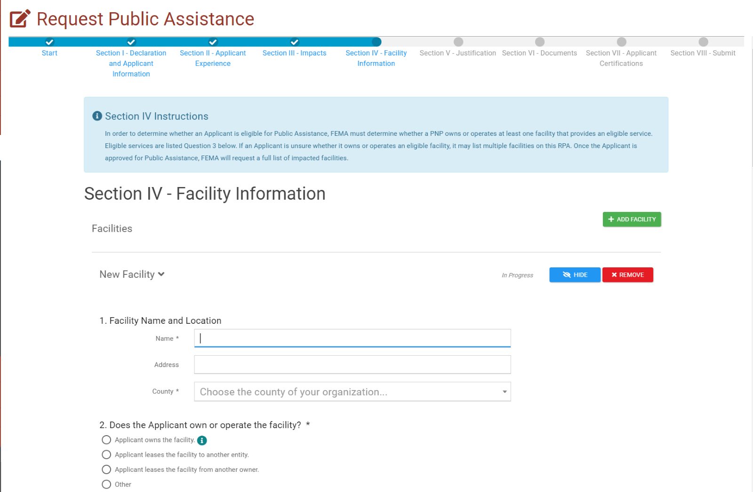
RPA - Facility Information 2/6
Select and Enter the applicable information

Slide 39
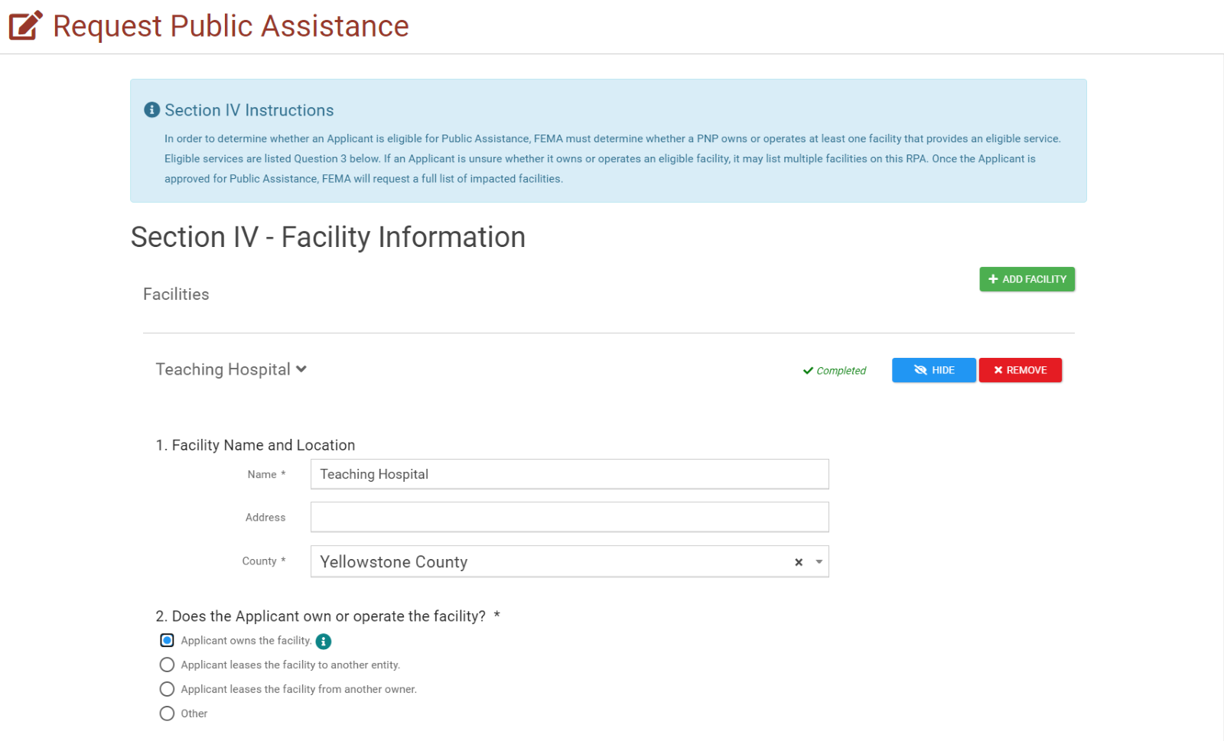
RPA - Facility Information 3/6
Enter the requested Information

Slide 40
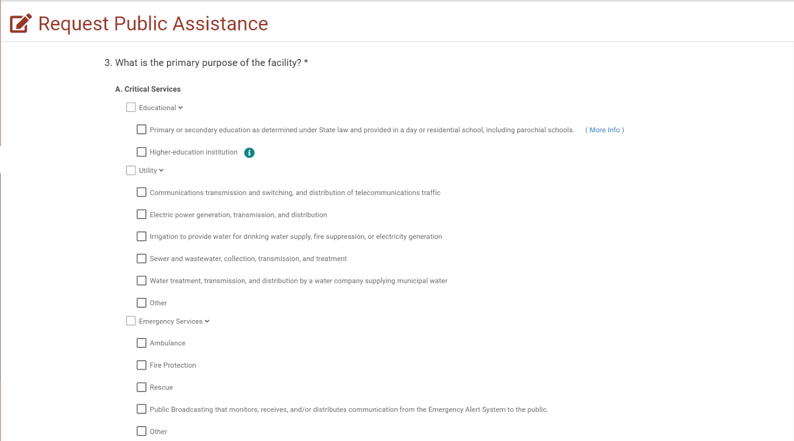
RPA - Facility Information 4/6
Select all applicable Primary services to that facility

Slide 41
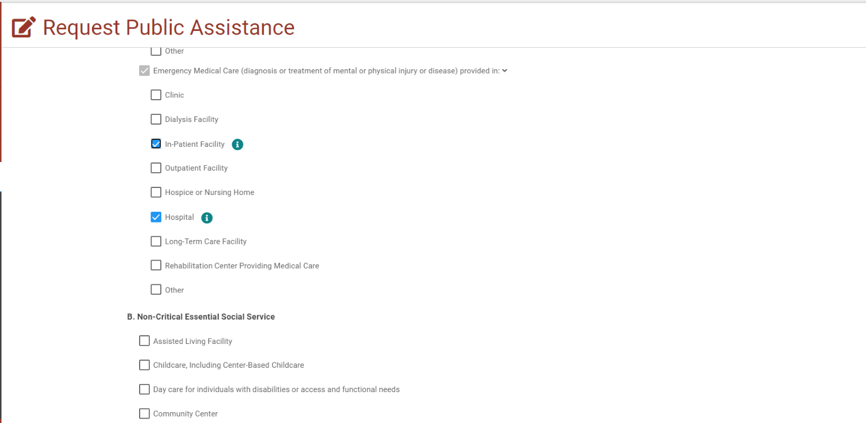
RPA - Facility Information 5/6
Ensure all primary functions are selected

Slide 42
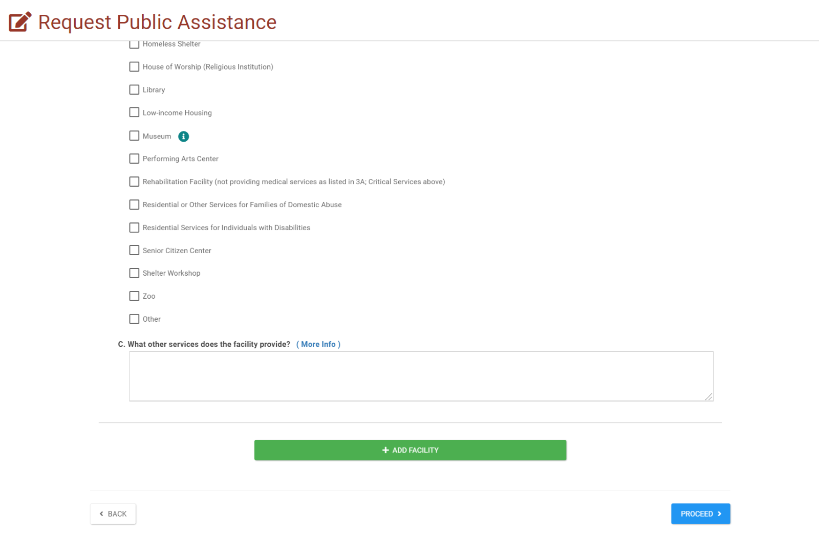
RPA - Facility Information 6/6
If there are additional facilities, click + ADD FACILITY and answer all the questions
If no additional facilities are needed, check for the green check mark and click Procced

Slide 43
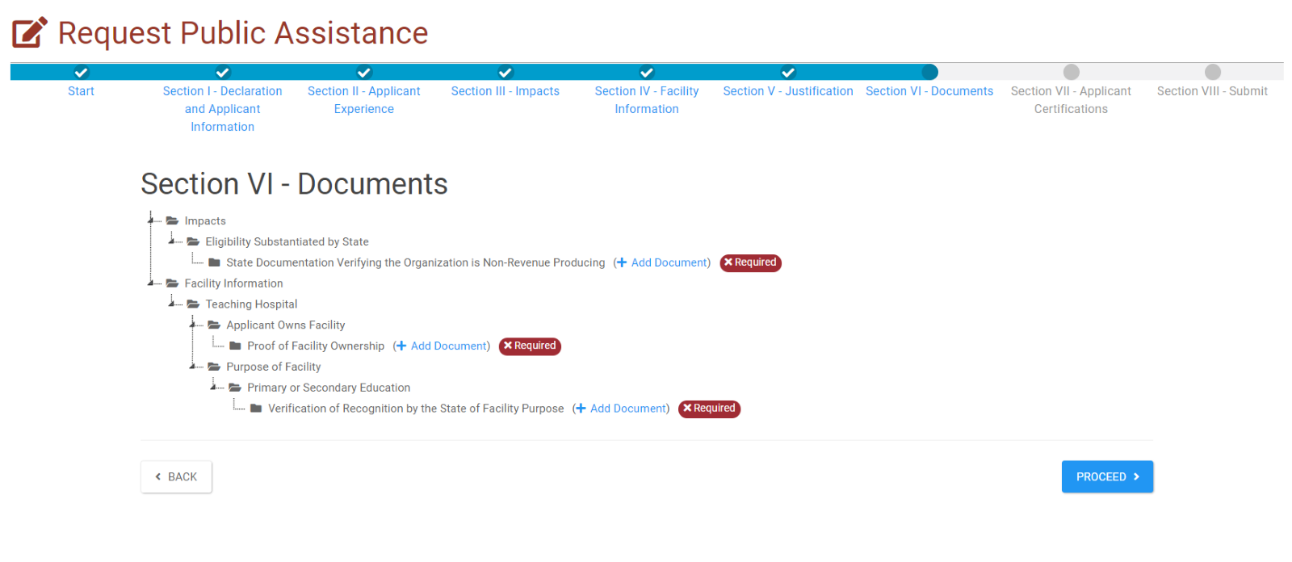
RPA - Documents 1/ 3
Click Add Document
Add all required documents.

Slide 44
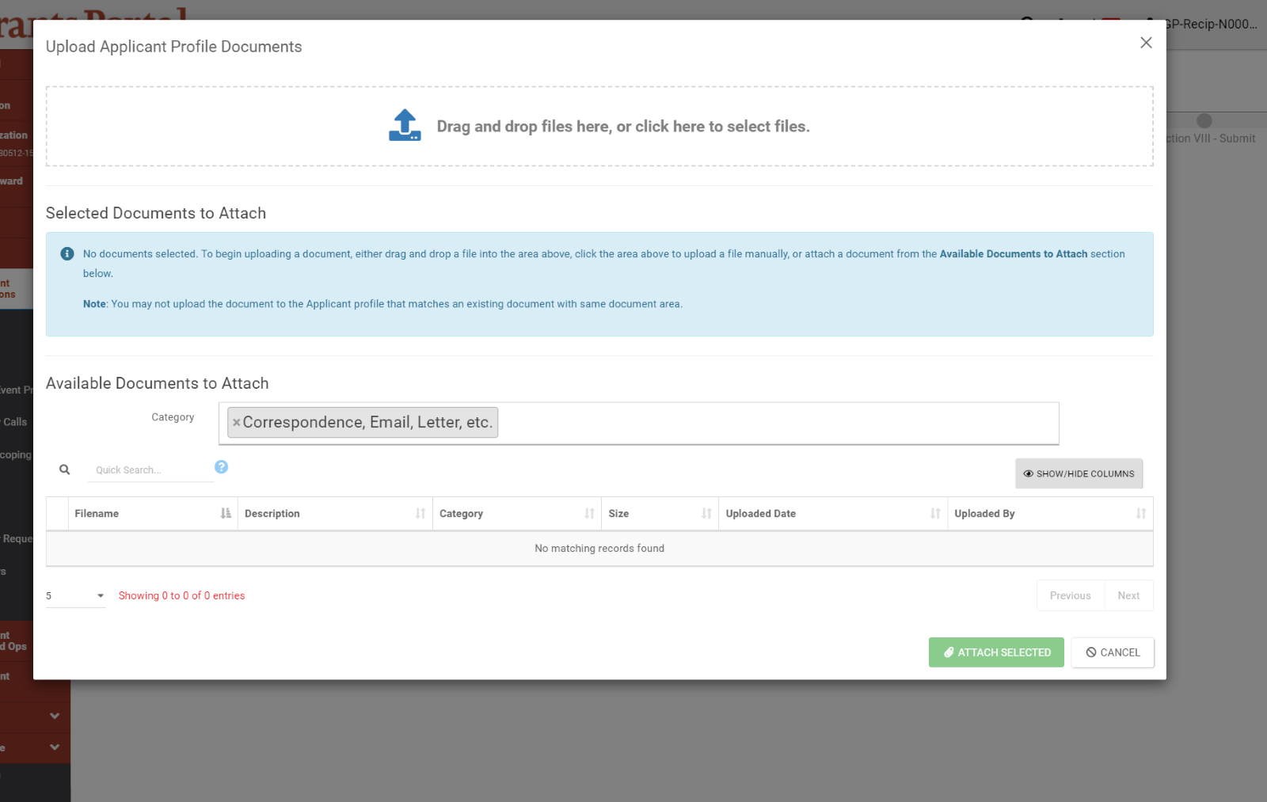
RPA - Documents 2/3
Click to Upload Documents

Slide 45
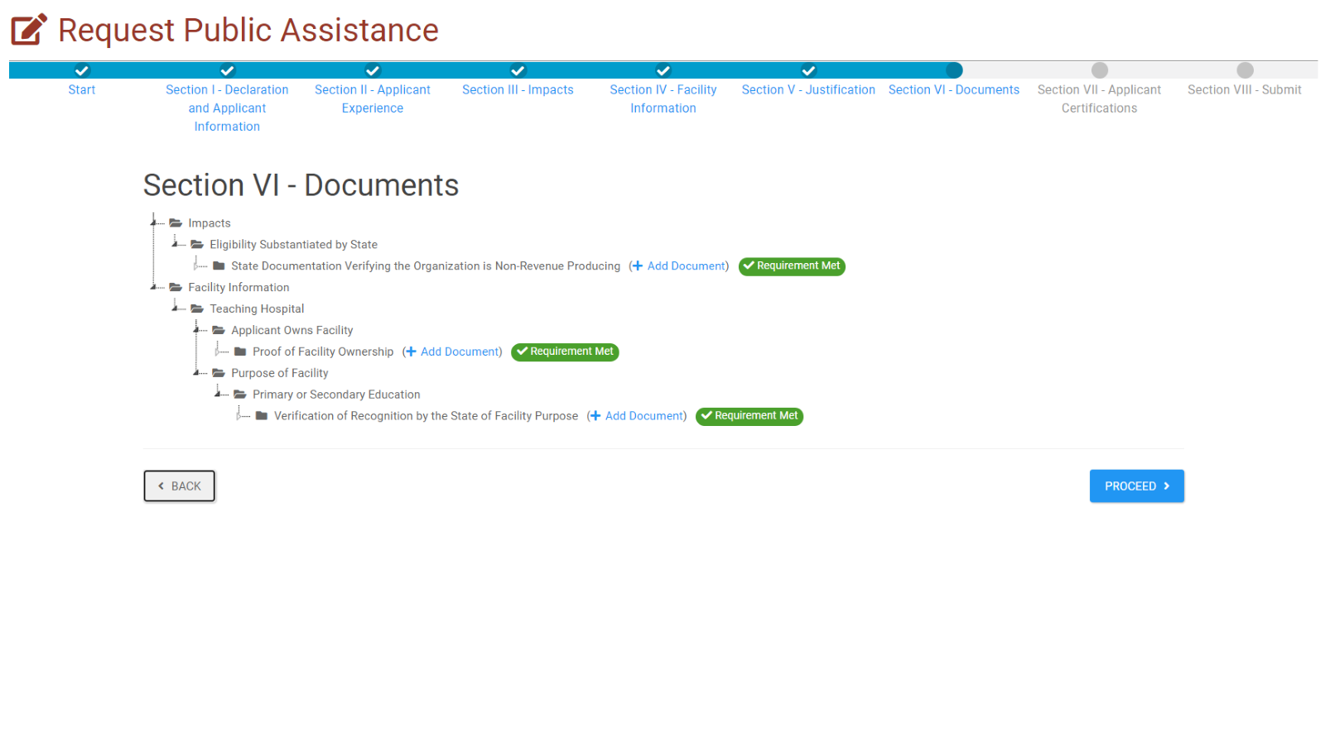
RPA - Documents 3/3
When ALL required documents were uploaded successfully; the system will allow to Proceed.
Click Proceed

Slide 46
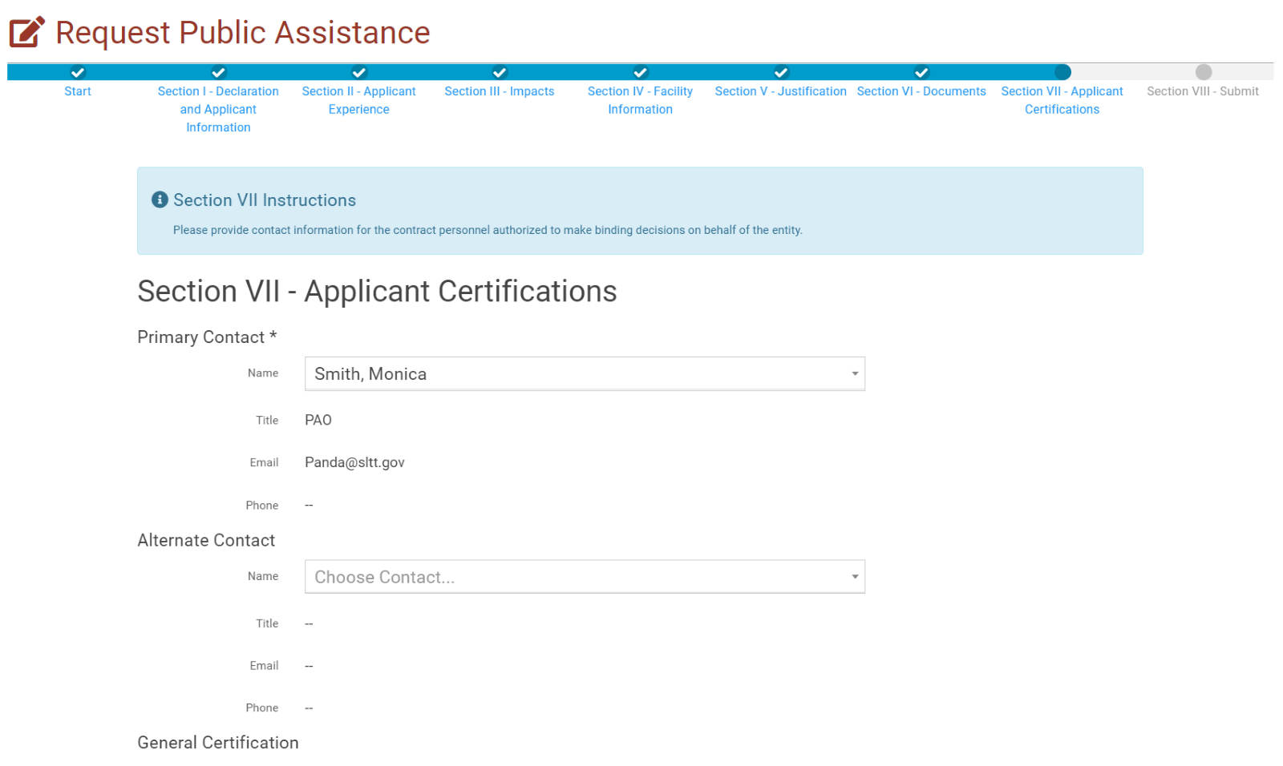
RPA - Applicant Certifications 1/2
Enter the information
Scroll down to Proceed

Slide 47
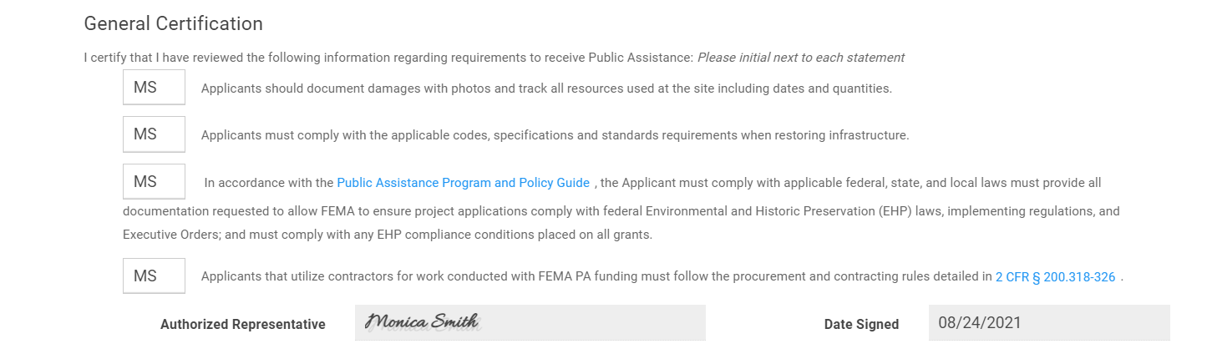
RPA - Applicant Certifications 2/2
In the small boxes, Enter initials to confirm accuracy of information provided
Sign the Certification
Click Proceed

Slide 48
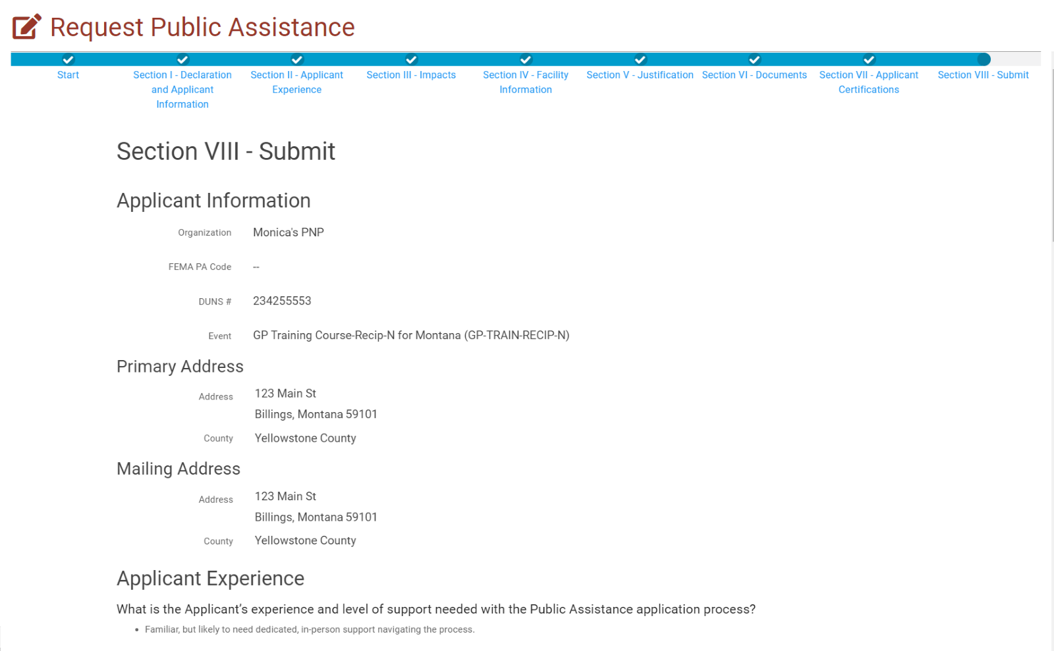
RPA – Review & Submit 1/3
Review all information for accuracy
Scroll down to Continue

Slide 49
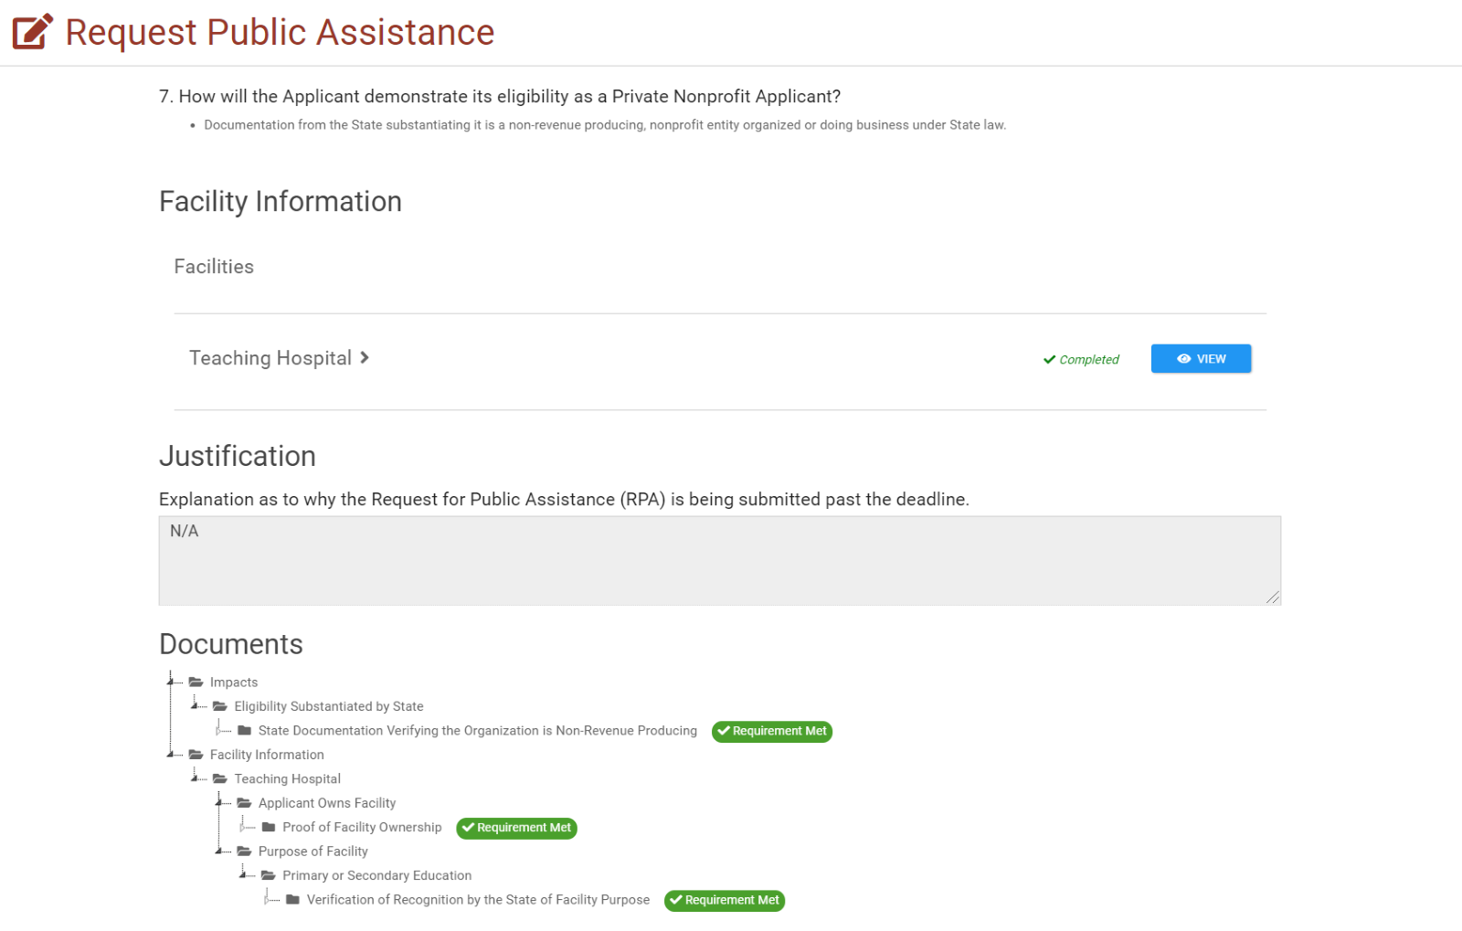
RPA – Review and Submit 2/3
Review all information for accuracy and all Required documents are uploaded
Scroll down to Proceed

Slide 50
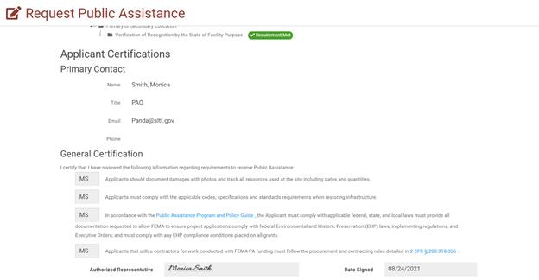

RPA – Review and Submit 3/3
Review all certifications for accuracy
Click Submit

Slide 51
Streamlined Project Application
Grants Portal Functionality

Slide 52
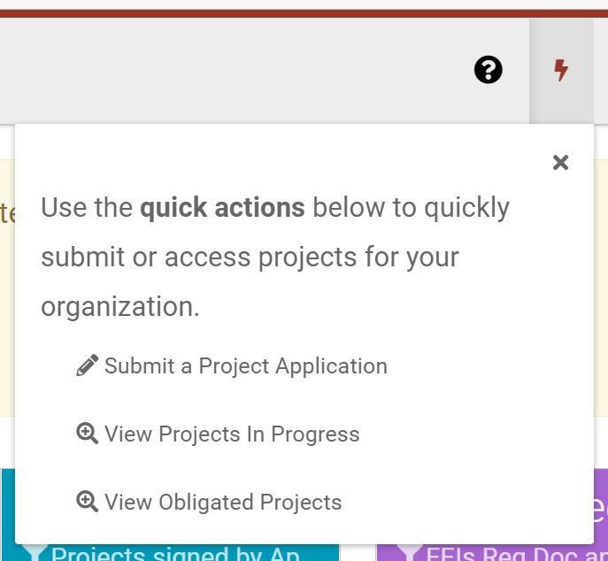
Quick Actions:
Create a Project
Application

Slide 53
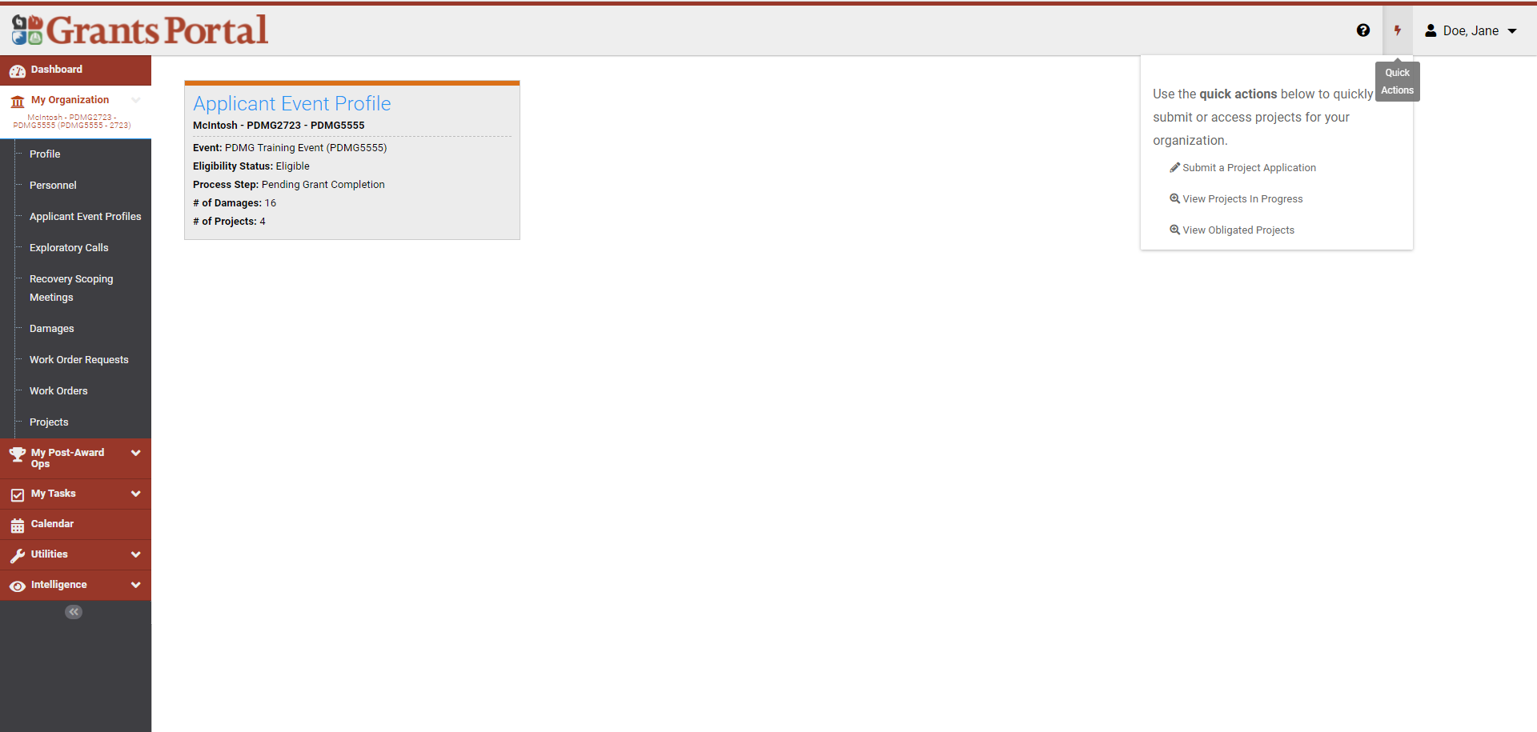
Lightning Bolt - Create a Project Application
Click the Lightning Bolt
Select Submit a Project Application
You can use this “quick action” to start/create a Streamlined Project Application. You will have the opportunity to save and return as needed.

Slide 54
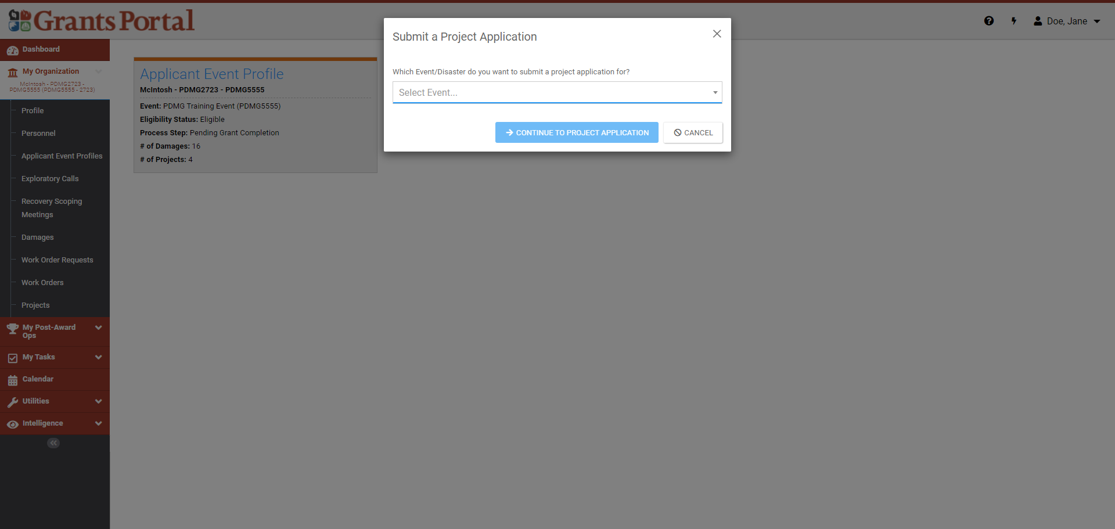
Lightning Bolt - Select Event
Click the Drop Down to Select the Event
Click Continue to Project Application to begin

Slide 55
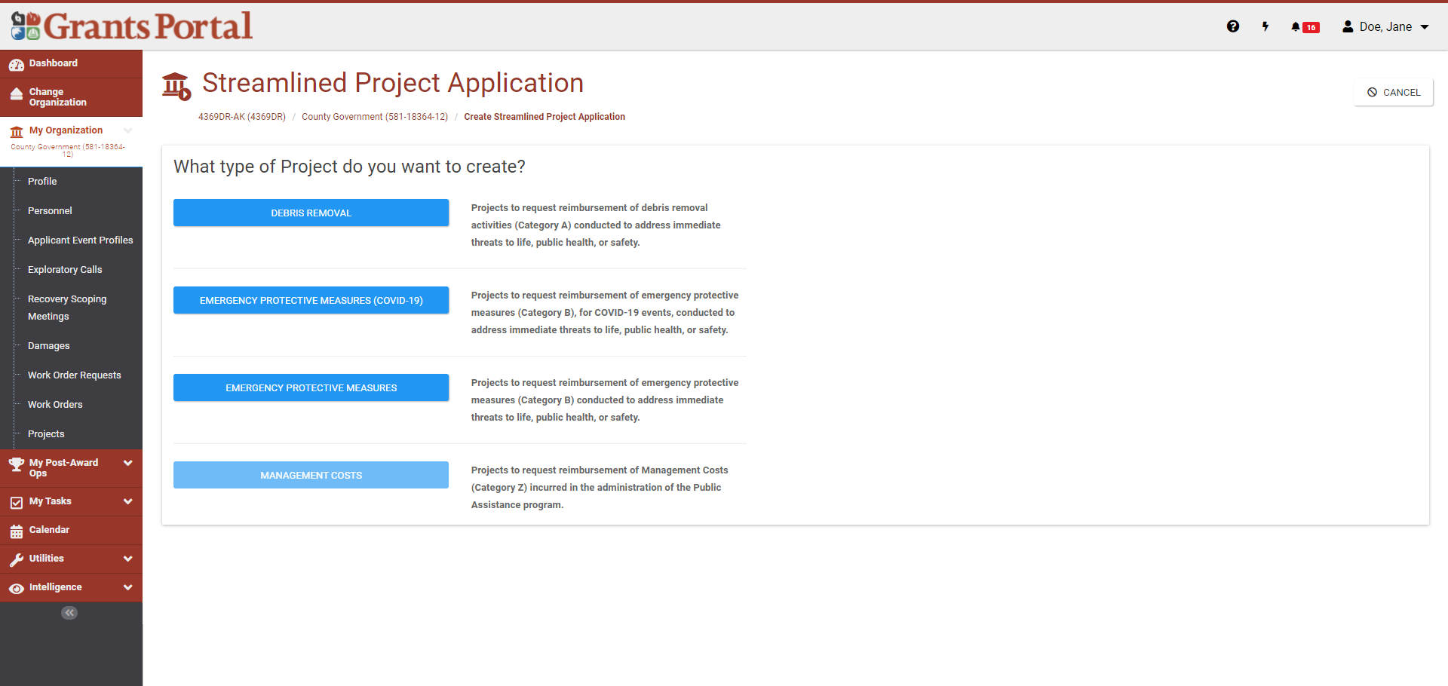
Select the Type of Project to Formulate
This page allows you to select the category of work and start a Streamlined Project Application if that is a process that’s enabled for your event

Slide 56
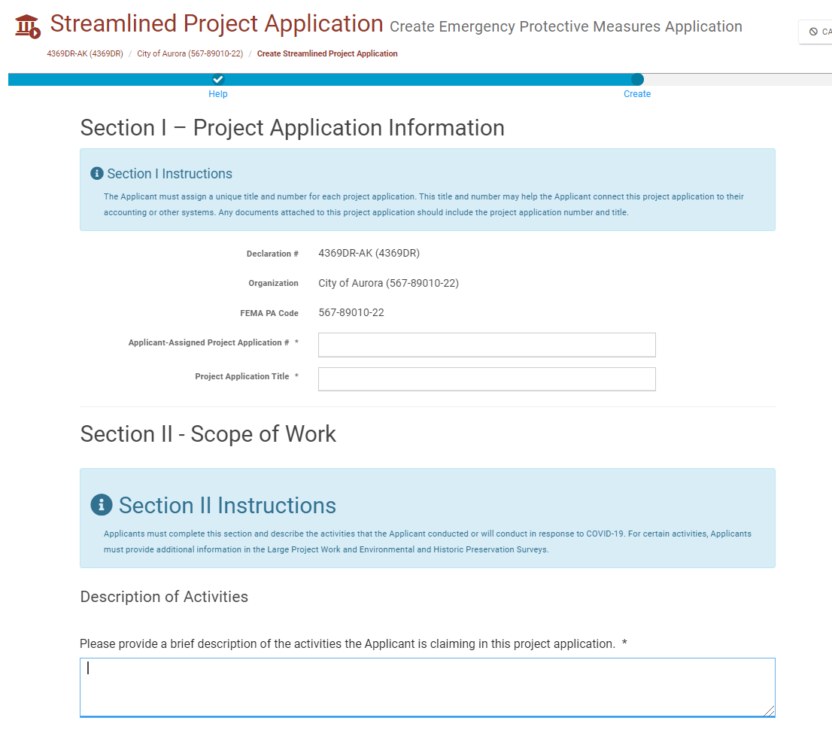
Streamlined Project Application Overview

Slide 57
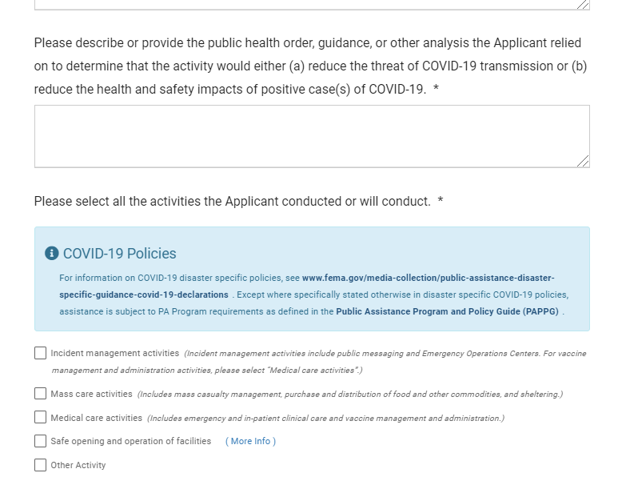
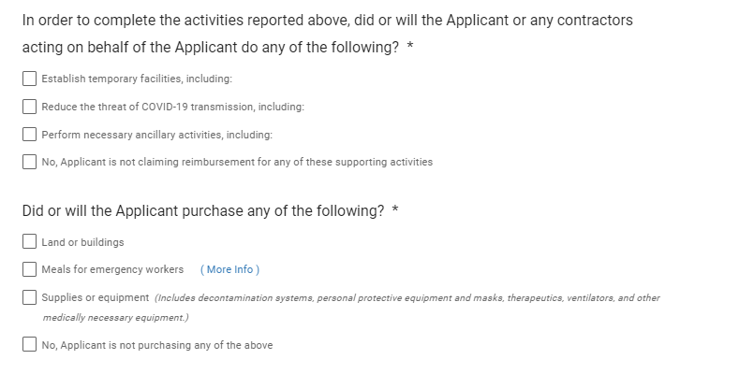
Streamlined Project Application Overview

Slide 58
Resources
GP Resources
  First Time Users - Org Creation and RPA submission – YouTube
  Grants Portal - "I'm logged in, now what?" – YouTube
Independent Study Courses - Emergency Management Institute - Independent Study (IS)
PAPPG -- Public Assistance Program and Policy Guide Version 4
PA Project Worksheets - Public Assistance Project Worksheets | FEMA.gov
GM/GP Customer Service Hotline 1-866-337-8448

Slide 59
Closing

Slide 60
Safeguarding Personally Identifiable Information (PII)
If you administer or manage documents for FEMA Grants, you are responsible for safeguarding personally identifiable information (PII) consistent with applicable federal, state, local, and tribal laws regarding privacy and obligations of confidentiality
PII is any information that can directly or indirectly identify an individual, including a name, address, date of birth, driver’s license or Social Security number, or financial account information and MUST not be uploaded into the Grants Portal or Grants Manager

Slide 61
Compliance Information
DHS Office of Inspector General
Procurement Guidance
Use to report Corruption, Waste, Fraud, Abuse, Mismanagement and Misconduct to the Department of Homeland Security Office of Inspector General.
Phone: 1-800-323-8603
DHS Office of Inspector General/MAIL STOP 0305
Attention: Hotline
245 Murray Lane SW
Washington, DC 20528-0305
PDAT – Procurement Disaster Assistance Team
FEMA’s Procurement Guidance for Recipients and Subrecipients Under 2 C.F.R. Part 200 (Uniform Rules) provides additional details regarding Federal procurement and contracting requirements.
https://www.fema.gov/grants/procurement
Federal Emergency Management Agency
61

Slide 62



Support
Public Assistance Hotline
Call Support: (866) 337-8448
National Hotline Hours of Operation: 8:00 AM - 8:00 PM EST, Monday through Friday.
Puerto Rico Hotline Hours of Operation: 8:30 AM - 5:00 PM AST, Monday through Friday
Email Support: FEMA-Recovery-PA-Grants@fema.dhs.gov
Webinar Videos
Videos are available on Youtube.com
Search “FEMA Grants Portal”

Slide 63
Thank you!

Slide 64
Discussion

Slide 65
NAICU Contact Information
Government Relations General Email: governmentrelations@naicu.edu
Sarah A. Flanagan
Vice President for Government Relations and Policy Development
Jody Feder
Director of Accountability and Regulatory Affairs
Stephanie Giesecke
Director of Budget and Appropriations
Emmanual Guillory
Director of Student and Institutional Aid Policy
Karin L. Johns
Director of Tax Policy
Robert (Bo) Newsome
Director of Outreach and State Relations

