Slide 1

Preparing for the Unexpected: Natural Disasters and FEMA
August 8, 2024

Slide 2
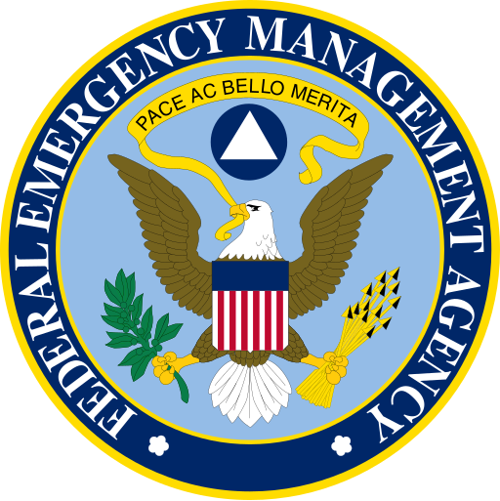
FEMA and the Stafford Act
The Robert T. Stafford Disaster Relief and Emergency Assistance Act is the authorizing statute for FEMA and the programs the Agency administers.
2006 Reauthorization:
Added language to clarify and ensure that private, non-profit colleges and universities are eligible to participate in grant programs.

Slide 3

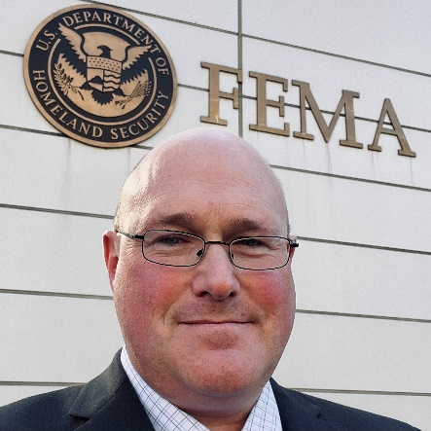
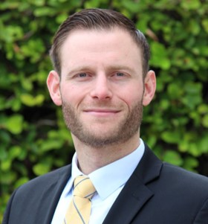
Today’s Presenters
Barbara Mistick
President
NAICU
Denver Appelhans
External Engagements Lead
Office of External Affairs
FEMA
Matt Shpiner
Executive Director of Emergency Management
University of Miami

Slide 4

Mindset and Preparation Questions

Slide 5
Federal Emergency Management Agency (FEMA)
Denver Applehans, External Engagements Lead, FEMA Office of External Affairs | August 8, 2024

Slide 6
FEMA’s Role in Emergency Management

Slide 7
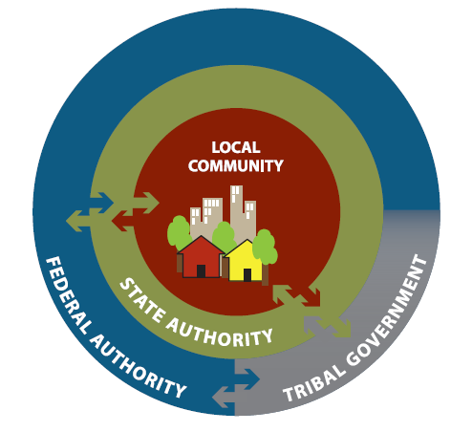
Emergency Management is a Team Effort
Just as we serve the whole community, we also rely on the whole community as our partners in emergency management.
FEMA does not, and cannot, serve as the sole or primary first responder.
Other Federal Agencies | State, Local, Tribal, and Territorial (SLTT) Governments | Non-profits | Private Sector | Individuals
Emergency management is most effective when locally executed, state managed,
and federally supported.
Local communities best understand their unique needs, opportunities, and risk.

Slide 8
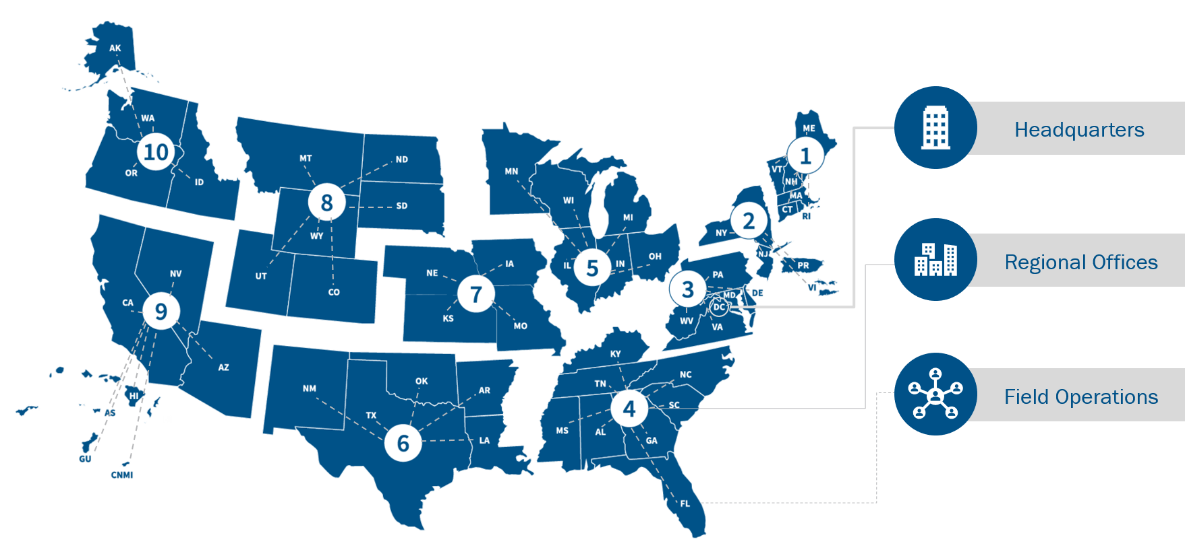
Where We Are Located

Slide 9
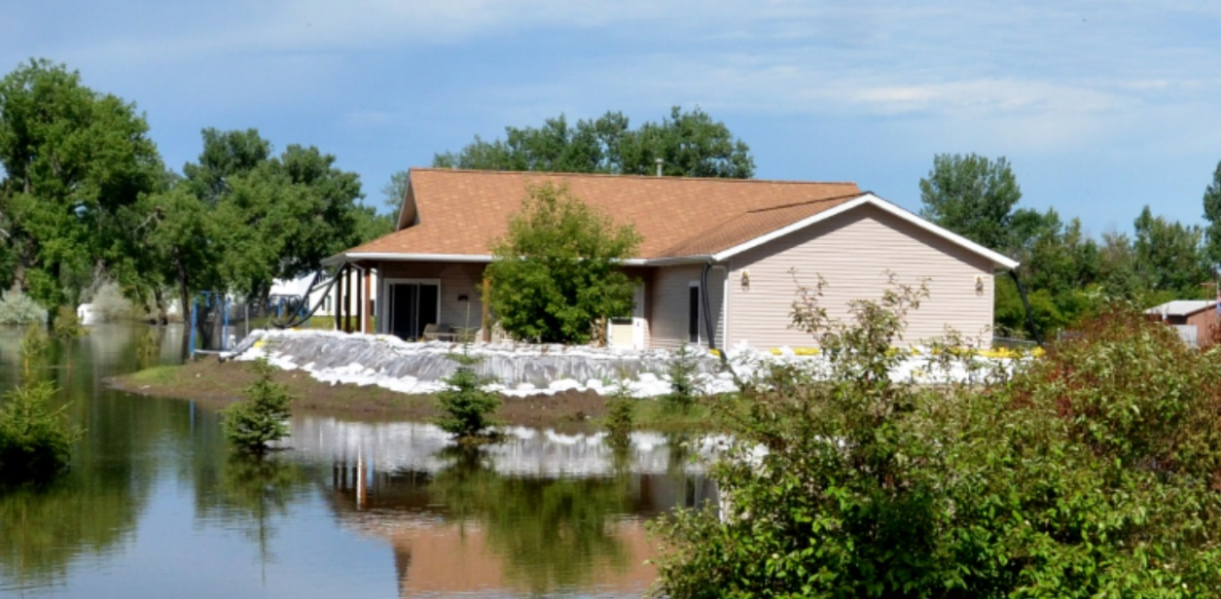
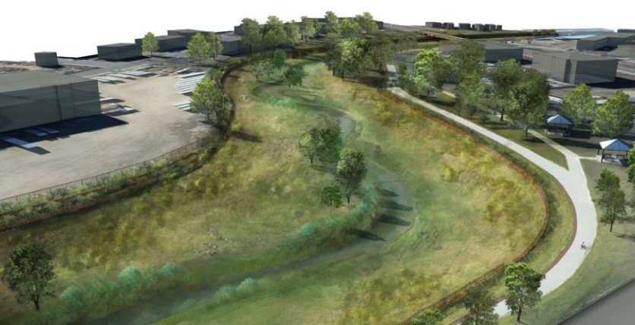
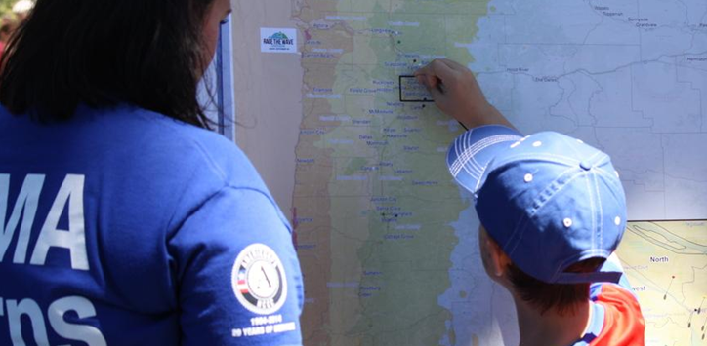
What We Do Before Disasters
Manage the National Flood Insurance Program (NFIP)
Provide Grants for Risk Reduction
Train and Educate
We provide flood insurance.
We encourage communities to adopt and enforce floodplain management regulations.
We partner with the insurance industry, lending institutions, and owners.
Every year we provide $2B through grant programs, including:
Building Resilient Infrastructure and Communities
Flood Mitigation Assistance
Hazard Mitigation Grant Program
Homeland Security Grant Program
In 2019, we provided training and education for 2.2 million students:
to strengthen emergency management core competencies.
to strengthen capacity to respond to and recover from disasters.
We lead national-level exercises.

Slide 10
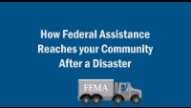
Disaster Response Process
When and how does FEMA respond?

Slide 11
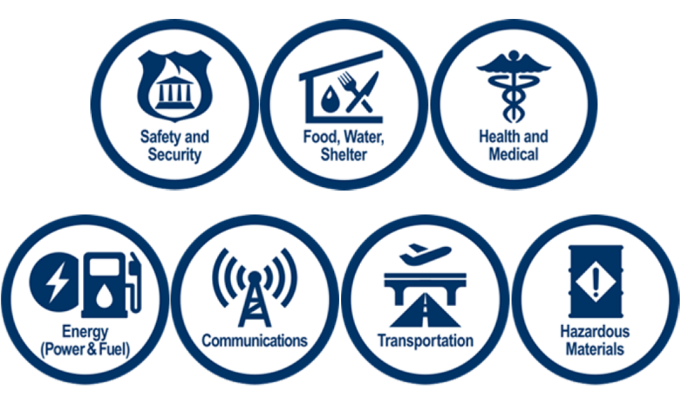
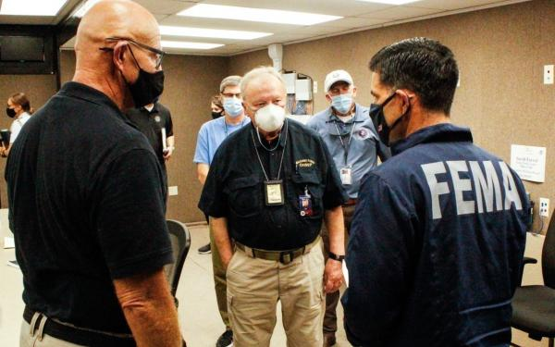
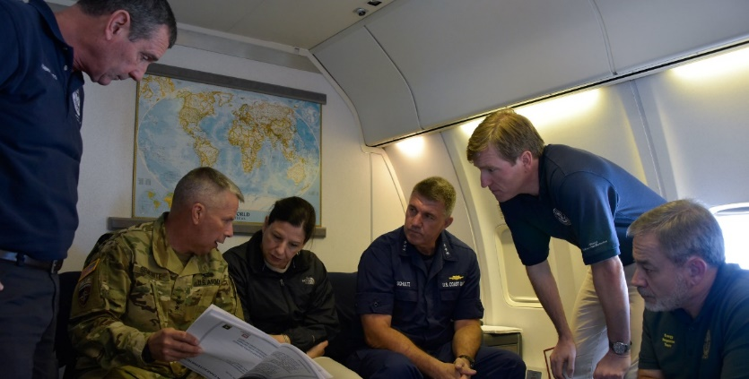
What We Do During Disasters
Assess Lifelines
Deliver Immediate Emergency Assistance
Ensure Continuity of Government
We activate Response Coordination Centers.
We coordinate mission assignments with other federal agencies.
We appoint a Federal Coordinating Officer.
We are the lead agency for ensuring the resilience and preservation of the government structure.
Continuity of Operations
Continuity of Government
Enduring Constitutional Government
We use lifelines to prioritize response activities.
A lifeline enables the continuous operation of critical business and government functions and is essential to human health and safety or economic security.

Slide 12
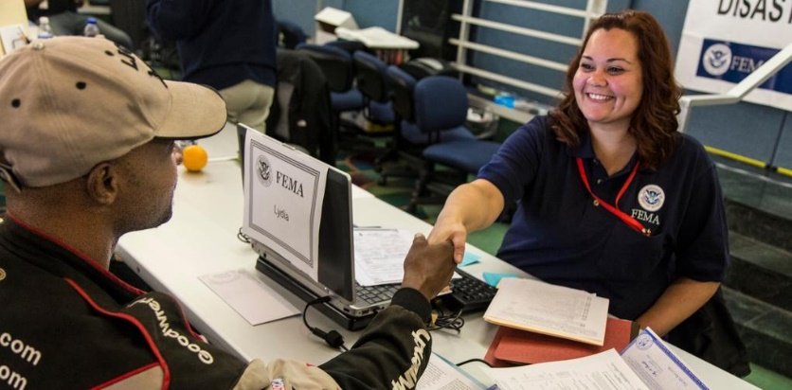
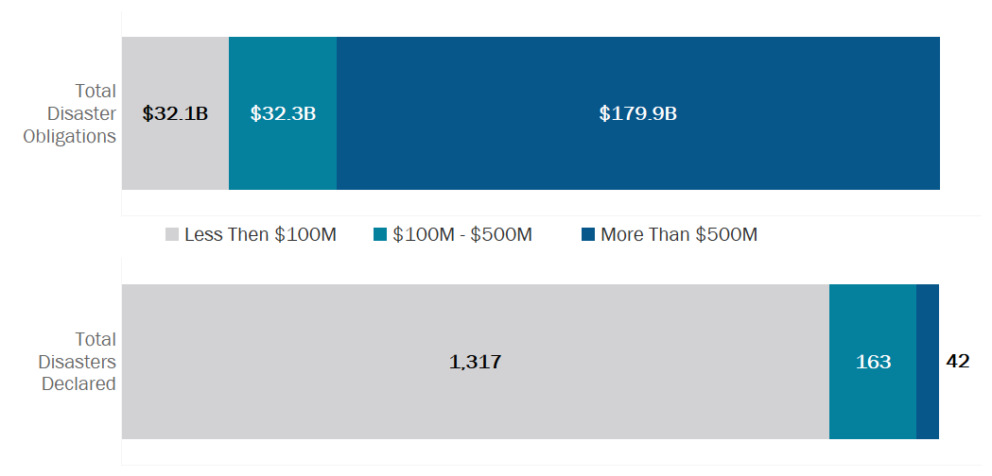
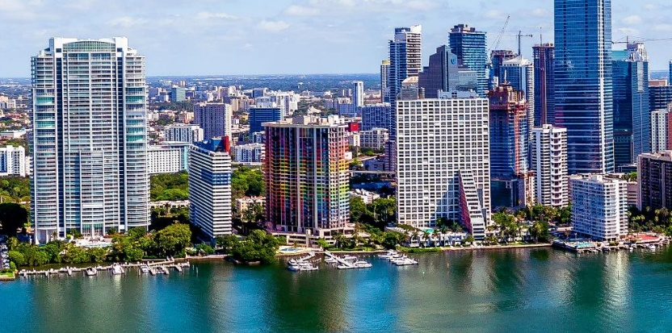
What We Do After Disasters
Employ the National Disaster Recovery Framework
Ensure Long-Term Resources are Available
Reduce Future Risk
We focus on how the whole community works together to restore, redevelop, and revitalize the health, social, economic, natural, and environmental fabric of the community.
Recovery can take years, especially for major disasters.
Our disaster spending is concentrated in events with declarations more than $500M.
In 2019, we provided over $1B for hazard mitigation grant projects following declared disasters.
We focus on vulnerable populations.
We innovate and partner to adapt.

Slide 13
Best Practices
How can we help?

Slide 14
Understand and Plan
Understand Your Risk
- Resilience Analysis and Planning Tool (RAPT) | FEMA.gov
Understand Your Part In Emergency Management
- Community Lifelines | FEMA.gov
Plan to Mitigate Disaster Risk
- Readiness and Emergency Management for Schools Technical Assistance Center (ed.gov)
- Planning Guides | FEMA.gov

Slide 15
Establish Relationships & Coordinate Plans
Establish Relationships with State, Local, Tribal & Territorial Emergency Management
- State Emergency Management Resources | REMS TA Center (ed.gov)
Establish Relationships Across Your Campus
- Leadership, Facilities Management, IT, Food Service, Contracting, etc.
Coordinate Your Plans Across Relationships
- Community Engagement, Campus Engagement, Clubs, Contracts

Slide 16

Communicate
Communicate with Staff, Faculty, Students and Community
- Communicate Risks as well as Plans
- New Employee and Student Orientation
Communicate your plans, how you practice and provide resources
- FEMA Mobile Products | FEMA.gov (FEMA App Social Media Toolkit)
- Integrated Public Alert & Warning System | FEMA.gov
- Ready Campus | Ready.gov

Slide 17
Exercise
Exercise your plans
Practice, walk through, find the gaps and bottlenecks, increase awareness
- Exercise and Preparedness Tools | FEMA.gov
- Emergency Management Toolkits - Preparedness Toolkit (fema.gov)
- Emergency Exercises: Practice and Validate Emergency Operations Plans (ed.gov)
- Test and adjust plans and systems based on outcomes

Slide 18
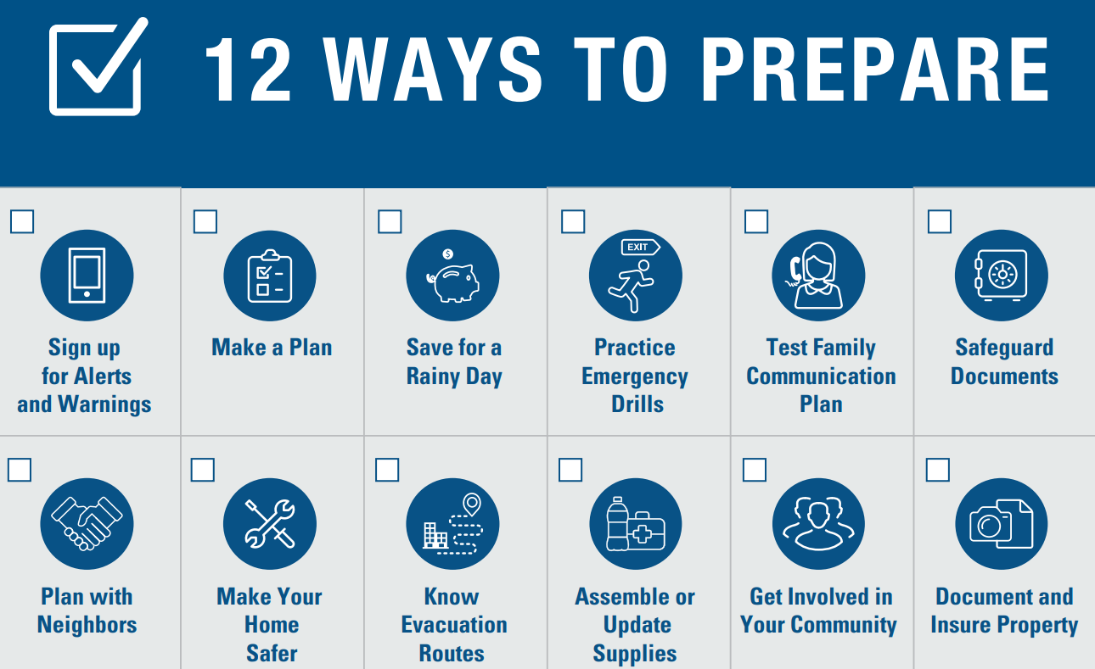

Key Takeaway
Understand and plan for how your institution fits into the bigger picture of emergency management in your area.
Establish relationships and coordinate plans with your local and state emergency management personnel.
Communicate emergency plans and procedures to faculty, staff and students.
Exercise plans and procedures regularly.

Slide 19
Additional Resources

Slide 20
Additional Resources
Preparedness Resources
- Ready Campus | Ready.gov
- Protective Actions Research Home Page (fema.gov)
- Readiness and Emergency Management for Schools Technical Assistance Center (ed.gov)
Post Disaster
- Assistance for Governments and Private Non-Profits After Disaster

Slide 21
Additional Resources
Training
- FEMA Emergency Management Institute
FEMA Higher Education Program | Campus Emergency Management Resources
- FEMA Organizations Preparing for Emergency Needs (OPEN) Program
(OPEN) Training | Disaster Preparedness Training & Resources (fema.gov)
- FEMA Community Emergency Response Team (CERT)
CERT Basic Training | Disaster Skills & Community Preparedness (fema.gov)

Slide 22
Helpful resources
Cyber Security
- CISA Resources: Recourses for Cybersecurity Clinics (cisa.gov)
- Educational Institutions | Cybersecurity and Infrastructure Security Agency CISA
- Shields Up: Guidance for Organizations | CISA

Slide 23
Contact Slide Option 2
Denver Applehans
External Engagement Lead, FEMA Office of External Affairs
Denver.Applehans@fema.dhs.gov
FEMA-Private-Sector@fema.dhs.gov

Slide 24
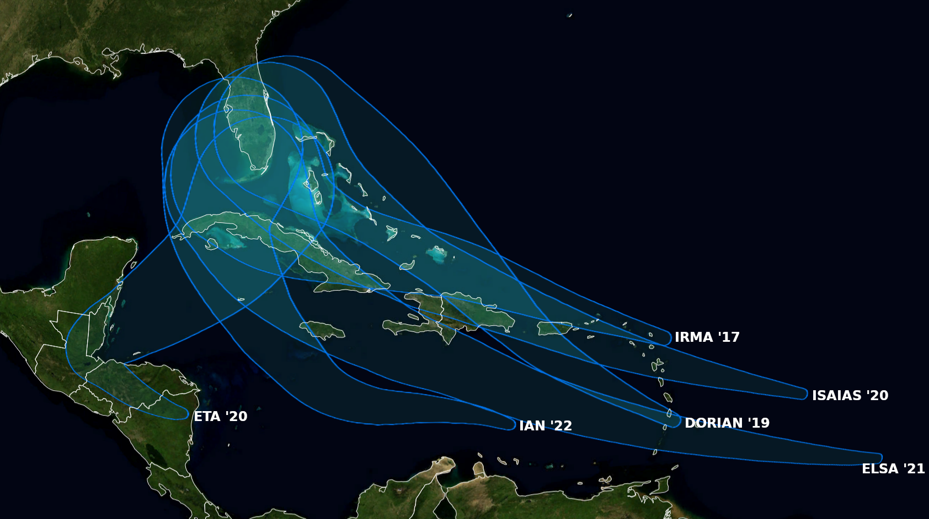
@BMcNoldy
PREPARING FOR THE UNEXPECTED: NATURAL DISASTERS AND FEMA
Natural Hazards Planning at the University of Miami
August 8, 2024

Slide 25
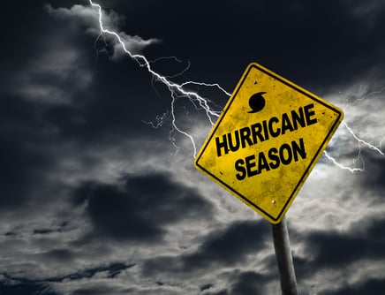
Topics
Risk Tolerance in an Evolving and Dynamic Threat Environment
Lessons Learned and Plan Enhancements
Tools for the Toolbox

Slide 26
What is our real risk tolerance?

Slide 27

Risk Tolerance in Relation to Evolving Threats
Impact
Impact
High
Low
High
Low
High
High
High impact and likely
to occur
Low impact and likely
to occur
High impact and likely
to occur
Low impact and likely
to occur
Likelihood
Likelihood
High impact but unlikely
to occur
Low impact and unlikely
to occur
High impact but less likely
to occur
Low impact and unlikely
to occur
Low
Low

Slide 28
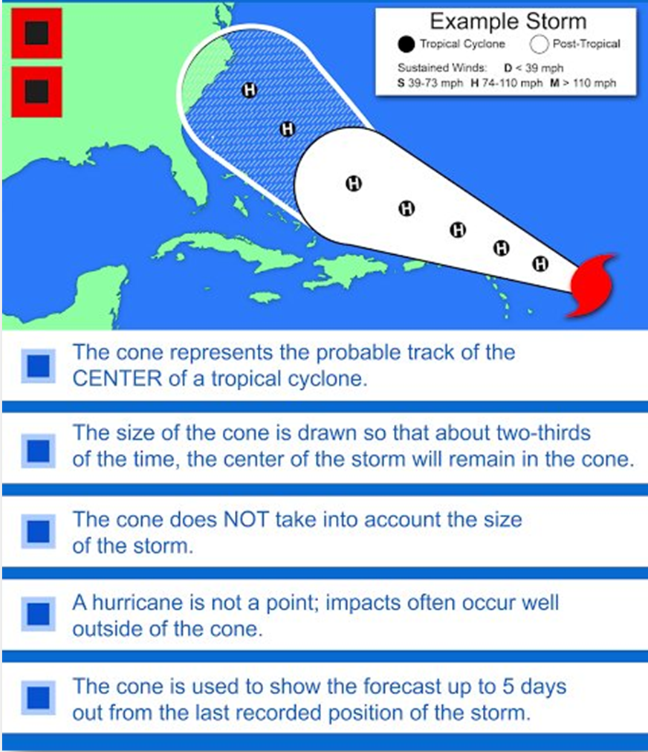
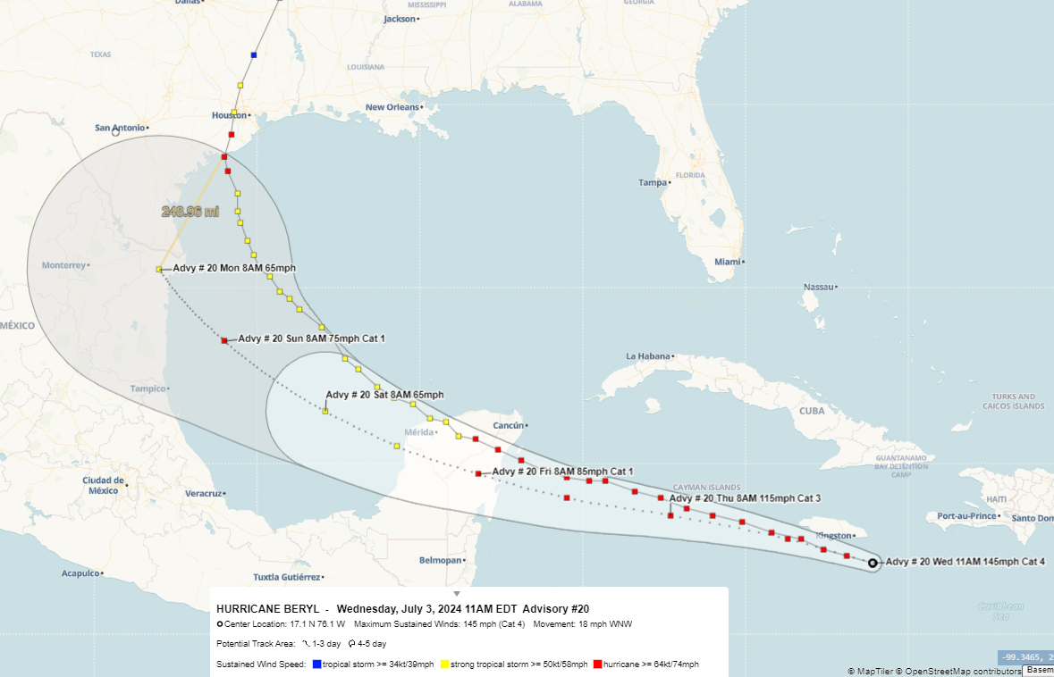
Avoiding Confirmation Bias
We don’t want bad things to happen

Slide 29
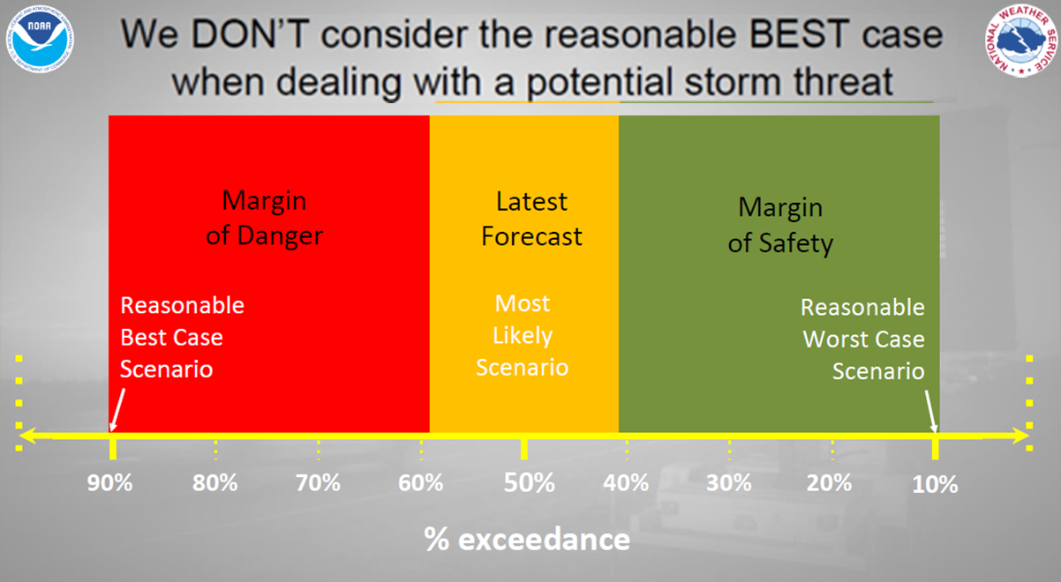
Reasonable Best v. Reasonable Worst

Slide 30
How do we execute better?

Slide 31
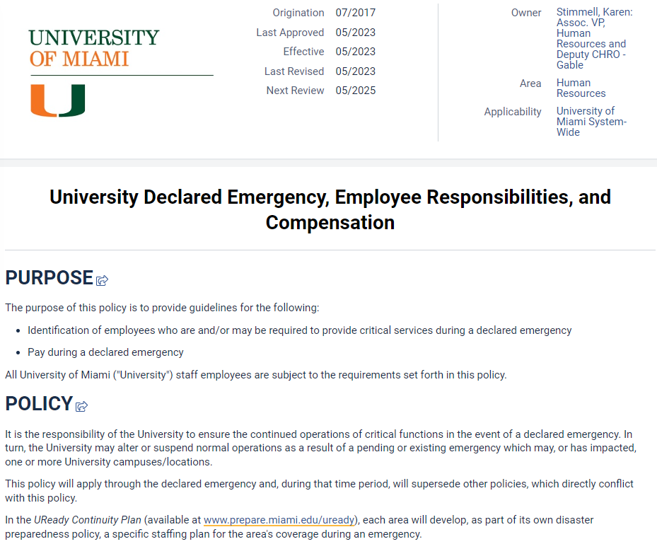
Workforce Planning
  Multi-Tier Structure to Pre-Identify Critical Employees
    Clearly identifying, setting expectations and discussing concerns with Tier 1 & 2 employees now
  New Opportunities and Challenges with Remote Work
    Tier 1 – Essential Personnel
    In Person – Cannot Work Remotely
    In Person – Can Work Remotely
    Remote Work - Lives in South Florida
    Remote Work - Lives Outside of South Florida
  Capability to identify employees in hardest hit areas
  Addressing Unmet Needs of the Institution

Slide 32
Simplifying Plans

Slide 33
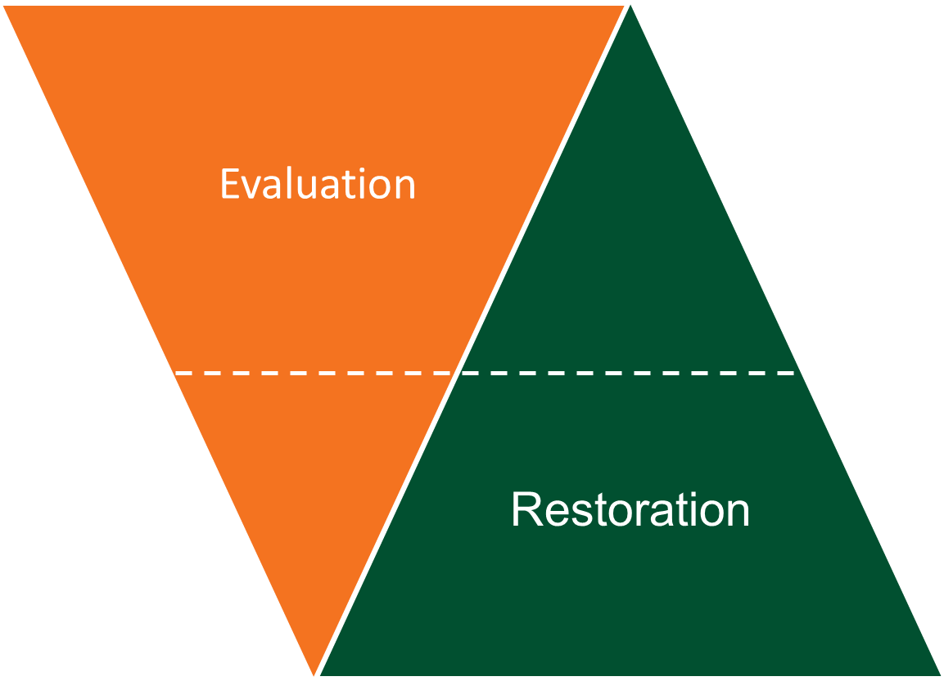
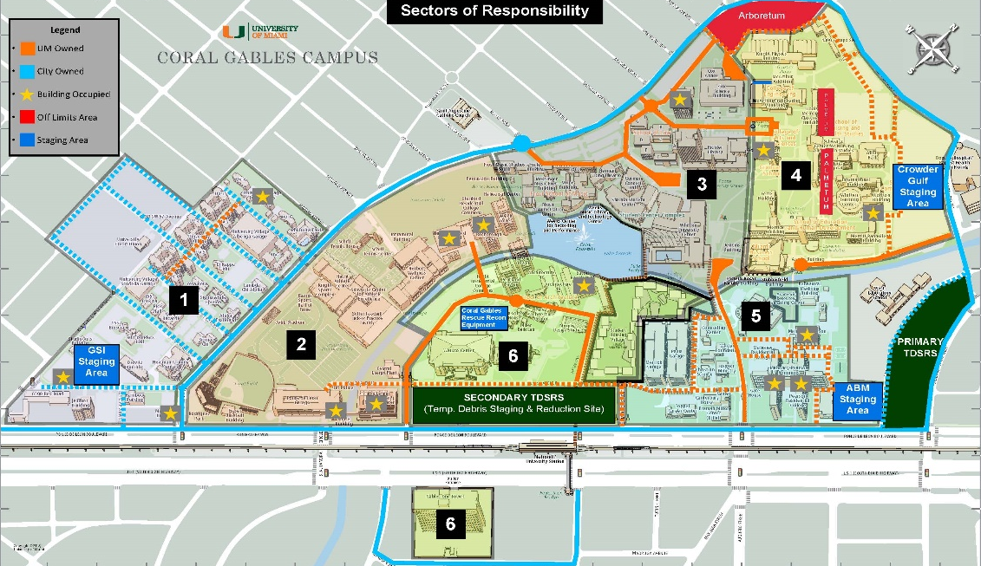
Damage Evaluation
Pre-Staged Resources to Expedite Recovery – Speed and Flexibility
Building Assessments
Phase 1 – Initial exterior campus assessment (by zone)
Phase 2 – Initial interior assessment of all buildings (by priority)
Phase 3 – Stabilize major impacts
Phase 4 – Detailed assessment of all buildings
Phase 5 – Stabilization of all impacts
Debris Removal
Phase 1 – Access for Emergency Responders
Phase 2 – Push debris from all roadways
Phase 3 – Move debris to staging site
Phase 4 – Dispose mulched debris to landfill site
Damage Evaluation Sectors

Slide 34
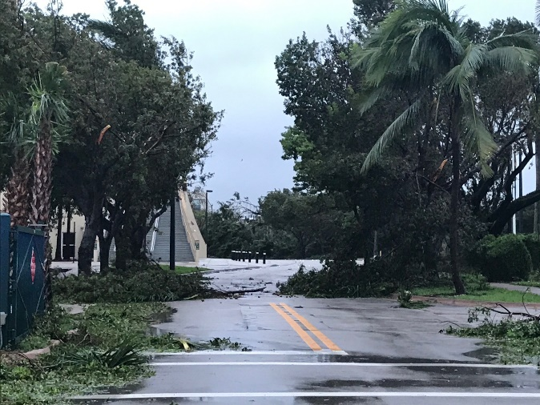

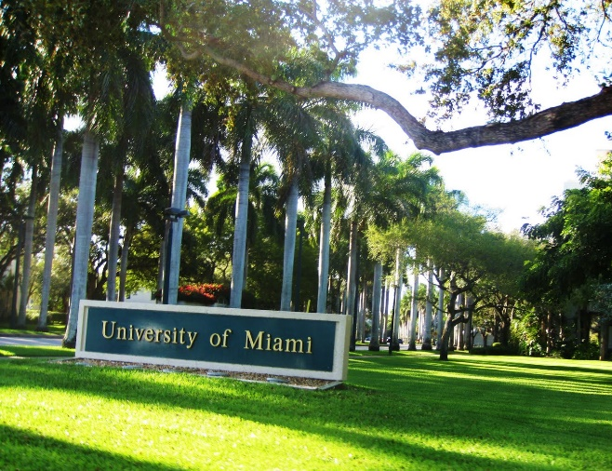
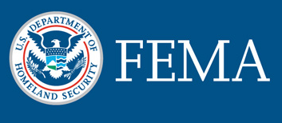
Planning for Recovery Before an Incident Occurs
  Disaster Contracts – Debris Monitoring, Debris Removal, Emergency Restoration, Public Assistance Consulting
  Photos
    Campus Photography (UAV, Street Level)
    Unit Level
  Decisions consistent with existing plans
    Document all actions and expenditures
  Standardizing process for tracking all disaster related costs - Disaster Projects in Workday

Slide 35
How do we use our relationships
as assets during an emergency?

Slide 36
Resource Survey
Asking Tough Internal Questions
  Do we have all the physical resources we need for the range of hazards and threats that we are vulnerable to?
  Do we have the full range of technical expertise for response to all incidents?
  What if the employees we rely on most are also impacted by an incident?
  How are we going to fill these gaps?

Slide 37

Access to Resources During a Disaster
No Single Solution
EMAC
Owned Assets
State Mutual Aid
Contracts
Other MOU/
MOAs
NIMAA

Slide 38
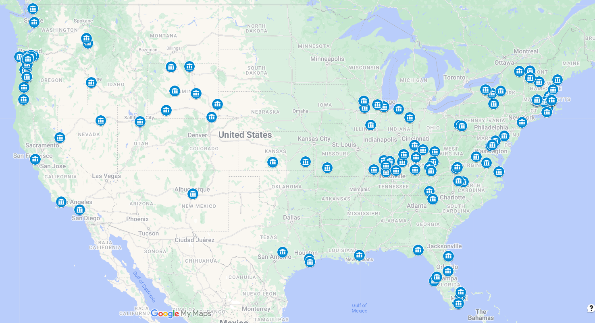
What is the National Intercollegiate Mutual Aid Agreement?
  Allows for the sharing of mutually agreed upon resources, based on agreed upon terms
  Founded in 2015 and today has 135 signatories
  Big and small, private and public, rural and urban, residential and non-residential
  No cost to join, requirements to use, or requirements to assist

Slide 39
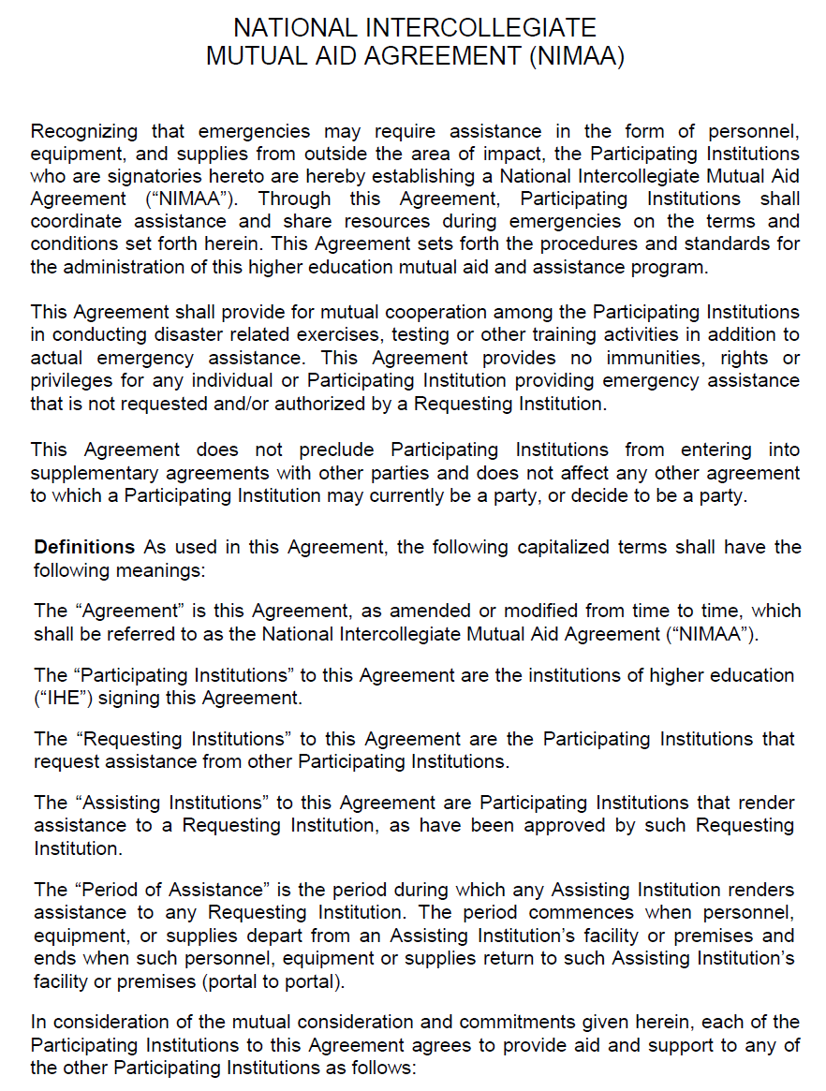
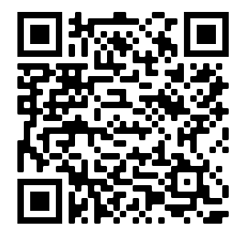
Elements of NIMAA
  Can be Used Locally, Regionally, Nationally
  Scope of Service
  Reimbursement Procedures
  Liability (insurance, worker compensation, etc.)
  Activation & Operational Control
  Limitations of Participating Institutions

Slide 40
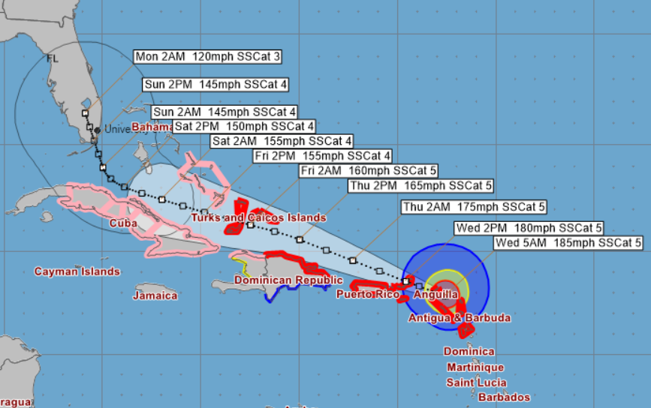


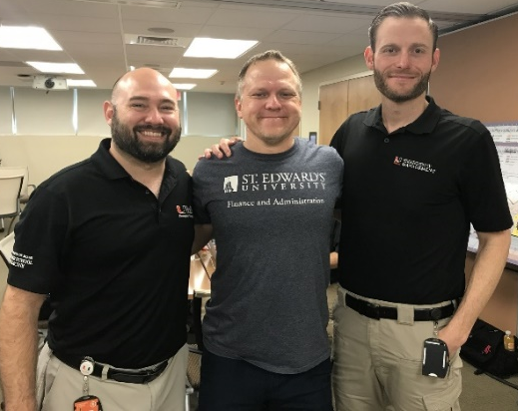
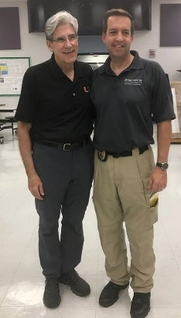
NIMAA Activations
2017 Hurricane Irma
EOC and Evacuation Center Support
Requesting Institution: University of Miami
Assisting Institutions: St. Edwards University &
SUNY Binghamton
2021 Presidential Inauguration
EOC Support
Requesting Institution: George Washington Univ.
Assisting Institutions: Virginia Tech &
University of Miami
You will never forget those that help in times of need!

Slide 41
Information into Action
Frequency / Impact Matrix – Expanding our Mindset
Next Level Planning – How Do We Execute
Increase and Diversify the Tools in the Toolbox – Become a NIMAA Signatory!

Slide 42
Matthew Shpiner
Executive Director of Emergency Management
University of Miami – Office of Emergency Management
mshpiner@miami.edu
(305) 284-3250

Slide 43
Questions and Discussion

Slide 44
Key Takeaways
UNDERSTAND how your institution fits into the bigger picture of emergency management in your area
1
ESTABLISH RELATIONSHIPS and coordinate plans with your local and state emergency management personnel
2
SHOULD:
Rely on Trusted Sources of Election Information
COMMUNICATE Emergency plans and procedures to faculty, staff and students
3
4
EXERSIZE plans and procedures regularly

